Slide 1

Azure AI Document Intelligence

Slide 2
Agenda
Overview
Prebuilt models
Custom models
Pricing
Toolkit sample for RAG chunking

Slide 3









Azure AI
Azure AI services
Bot Service
AI Search
Document Intelligence
Video Indexer
Immersive Reader
Content Safety
Vision
Speech
Language
Decision
Azure OpenAI Service
ML Platform
Azure Machine Learning
Azure AI Studio
AI Infrastructure

Slide 4
Azure AI Document Intelligence
A cloud-based Azure AI service that uses machine-learning models to extract key-value pairs, text, and tables from documents Easily identify, extract and analyze the following document data:
Structure and contents of the table Form elements and field values Entered and handwritten alphanumeric text Relationships between elements Key-value pairs Position of the element with bounding box coordinates

Slide 5
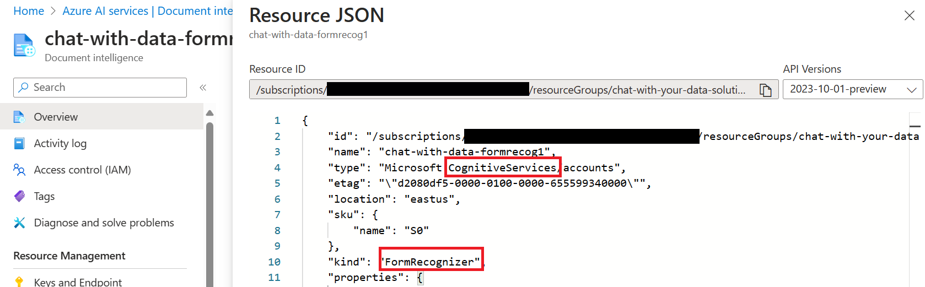
Name Update
Renaming from July 2023
Azure Cognitive Service / Azure Applied AI Services➔ Azure AI Services
Azure Form Recognizer ➔ Azure AI Document Intelligence
The names "Cognitive Services" and "Azure Applied AI" continue to be used in Azure billing, cost analysis, price list, and price APIs.
REST APIs and SDKs, 2023-10-31-preview and later, will be renamed document intelligence
Some platforms are still awaiting the renaming update. All mention of Form Recognizer or Document Intelligence in our documentation refers to the same Azure service.

Slide 6
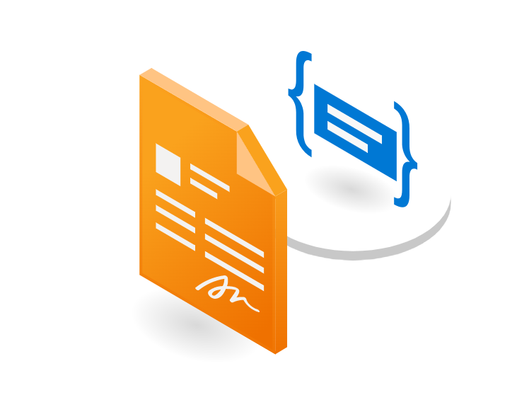
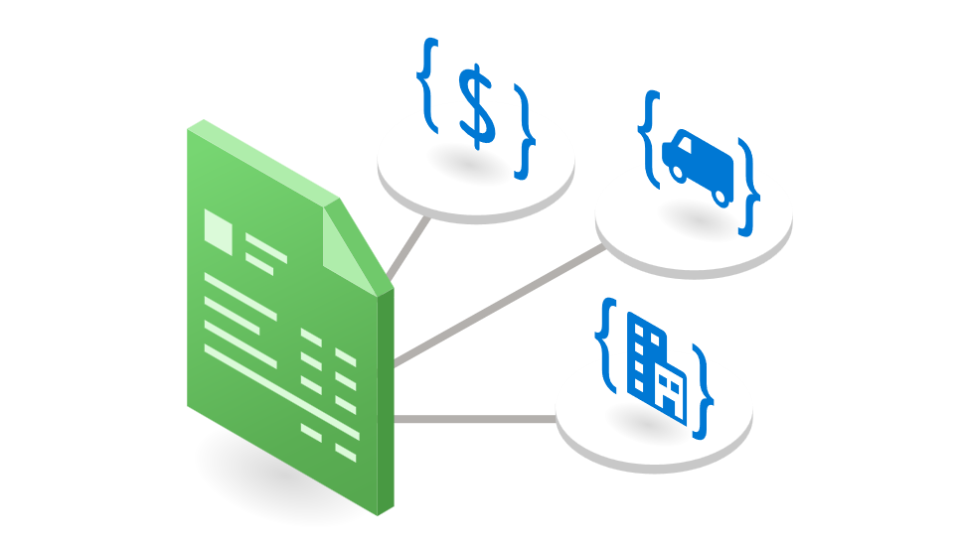



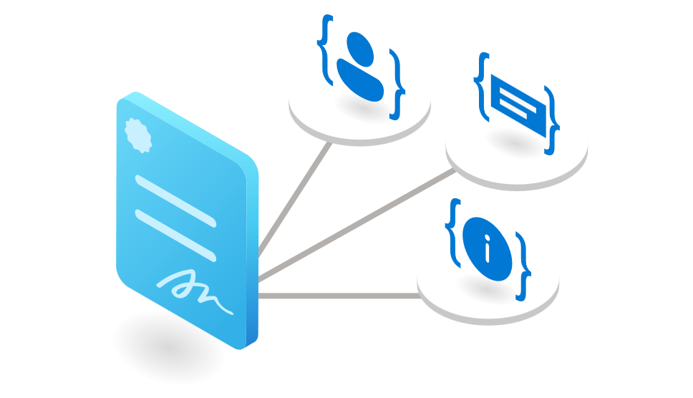

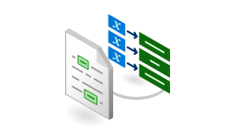

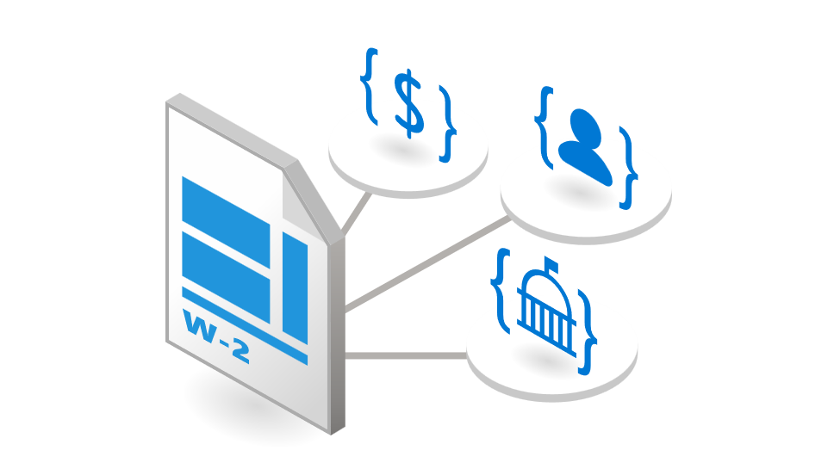

Document Intelligence Models
Document Analysis models
Prebuilt models
Custom models
Custom Template
Train models to extract text from any structured document type (static layouts)
Receipt
Invoice
Custom Neural
Read
Layout
Train models to extract text from structured and unstructured document types
Extract printed and handwritten text.
Extract text & structure, tables from documents
Extraction models
Custom composed
Extract data using a collection of models
Contracts
Identity documents
Deprecated from API version 2023-10-31-preview
Replaced with Layout model with the new key value pairs feature
General Document
Custom Classifier
Train models to Identify designated document types (classes) before invoking an extraction model
Business
cards
US Tax
forms
Classification
models

Slide 7
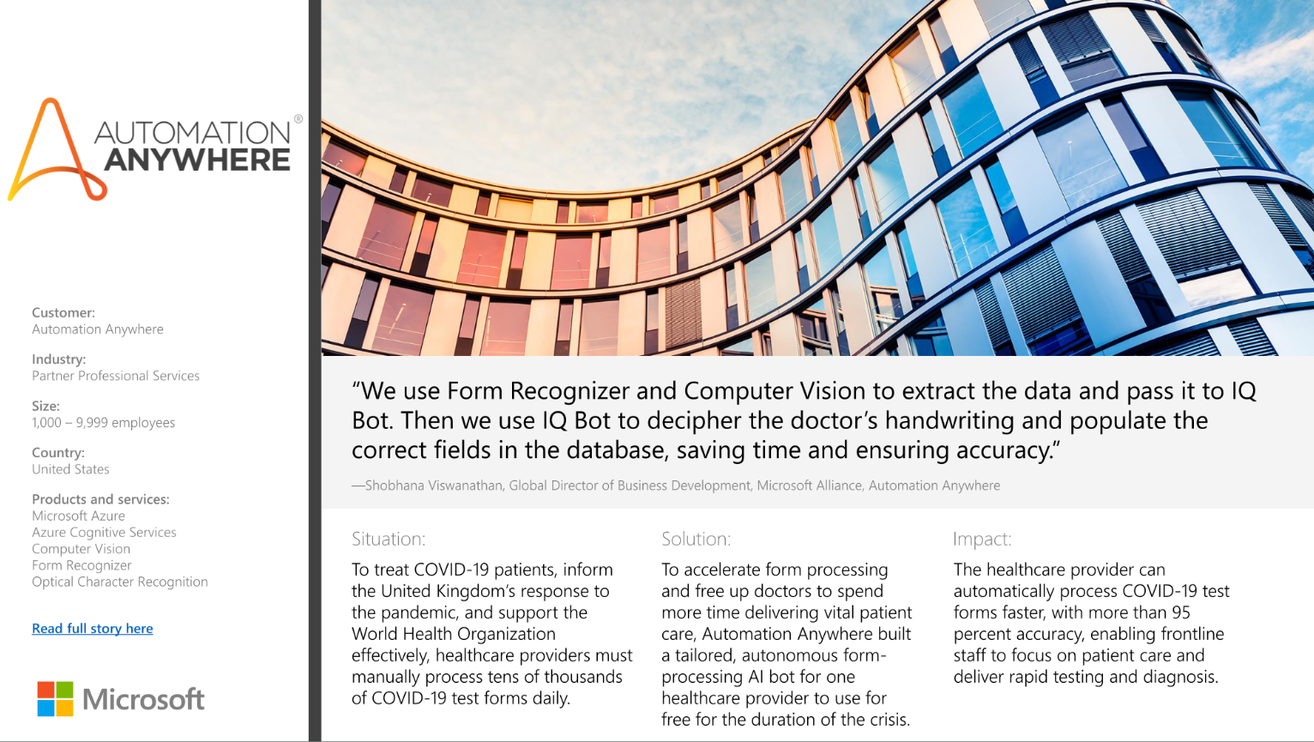

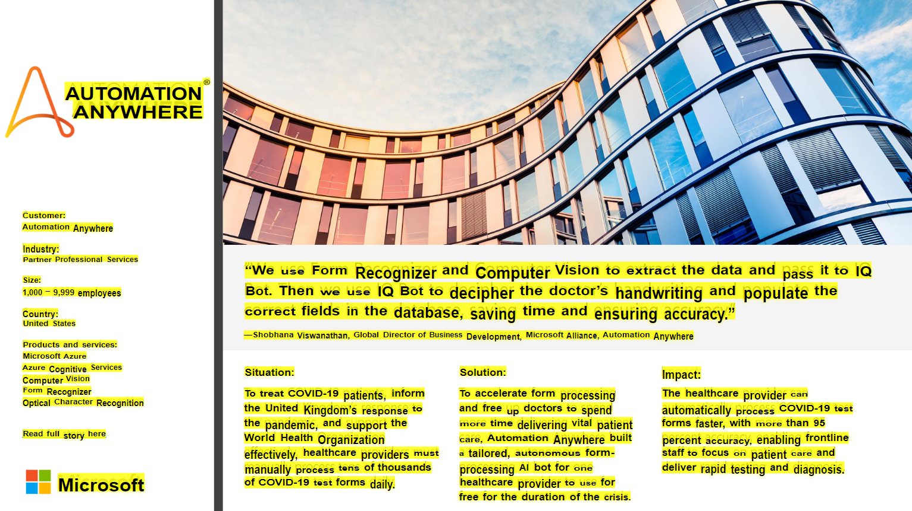

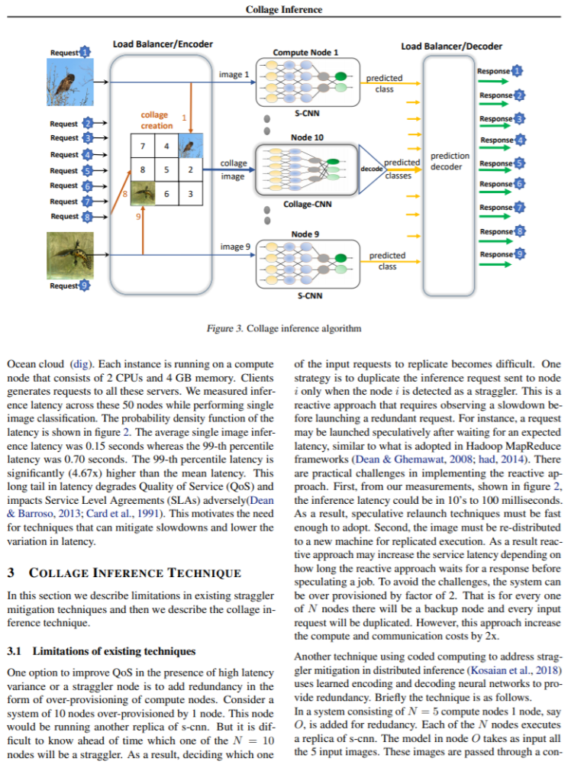
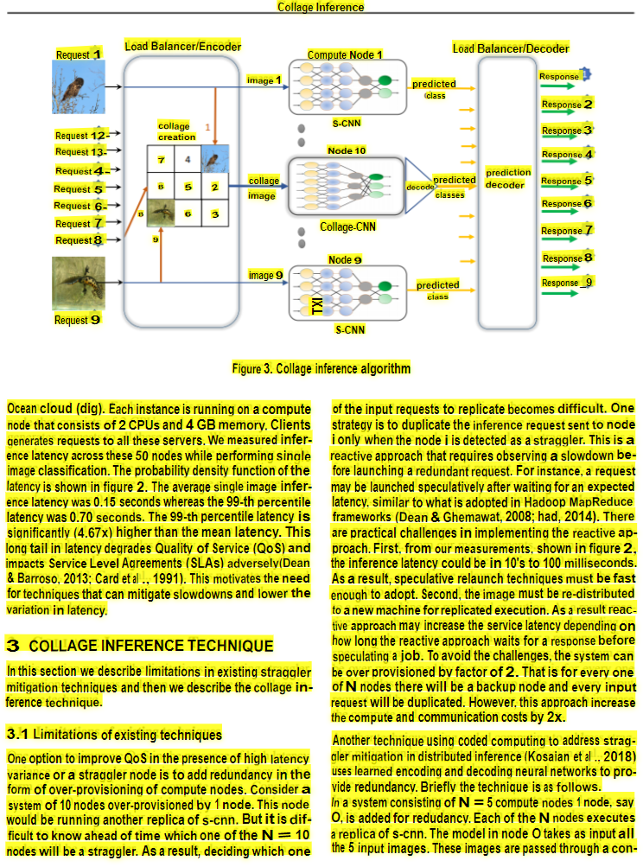
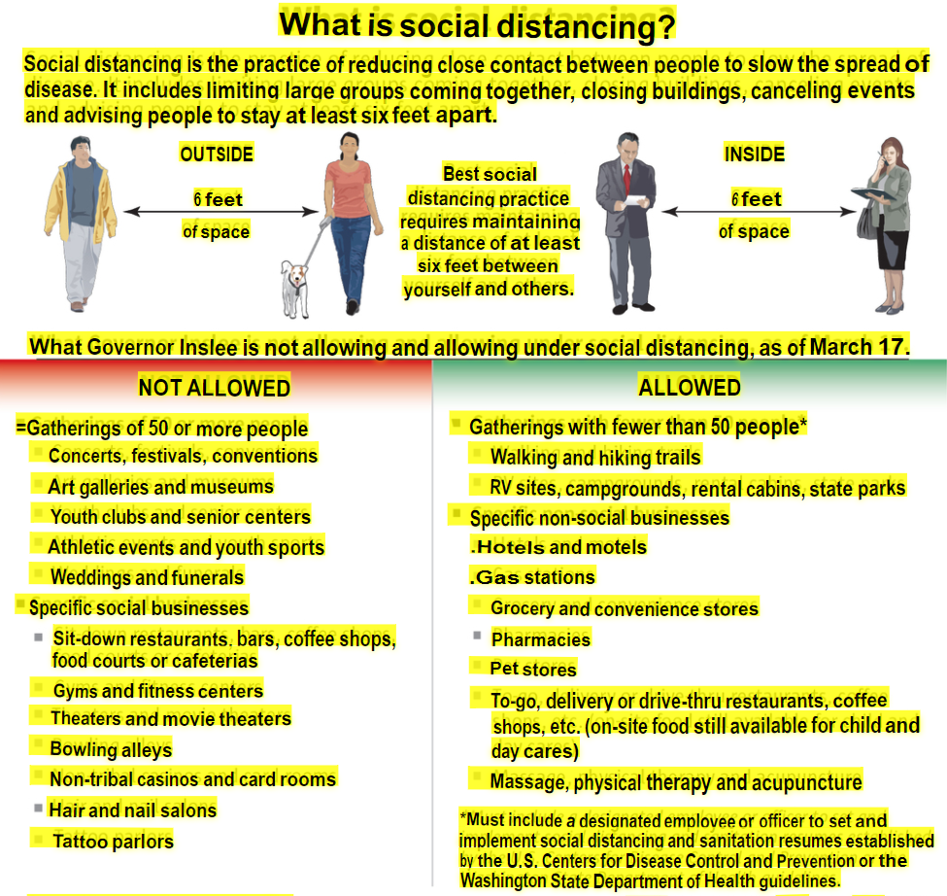
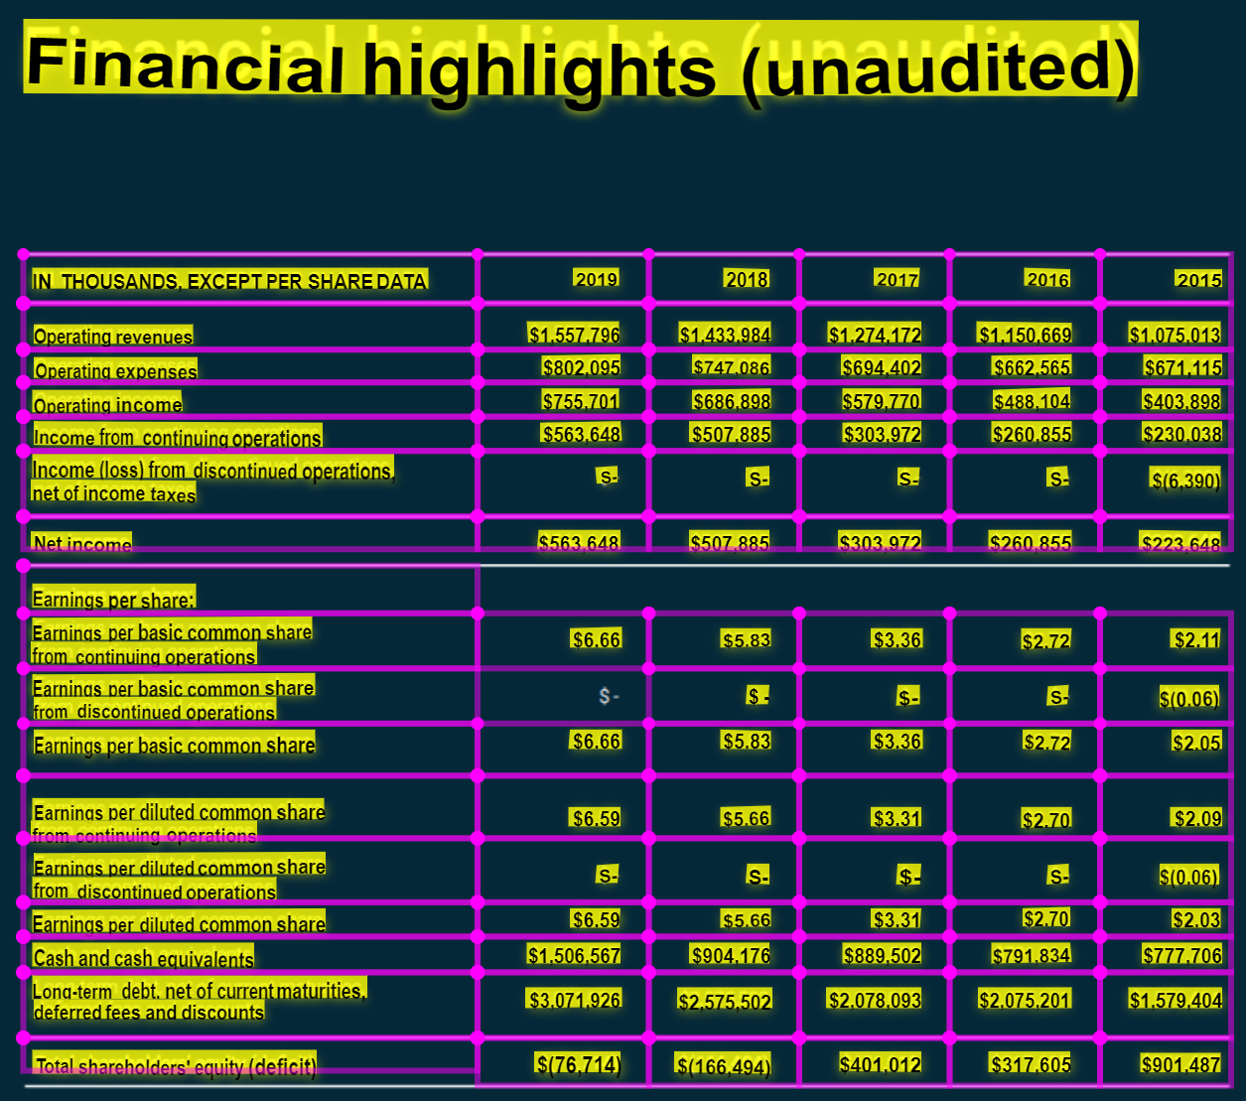

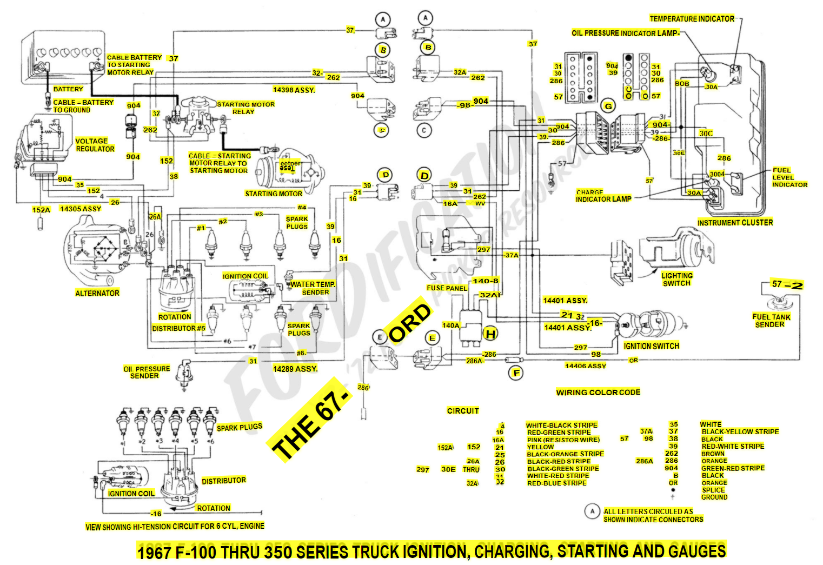
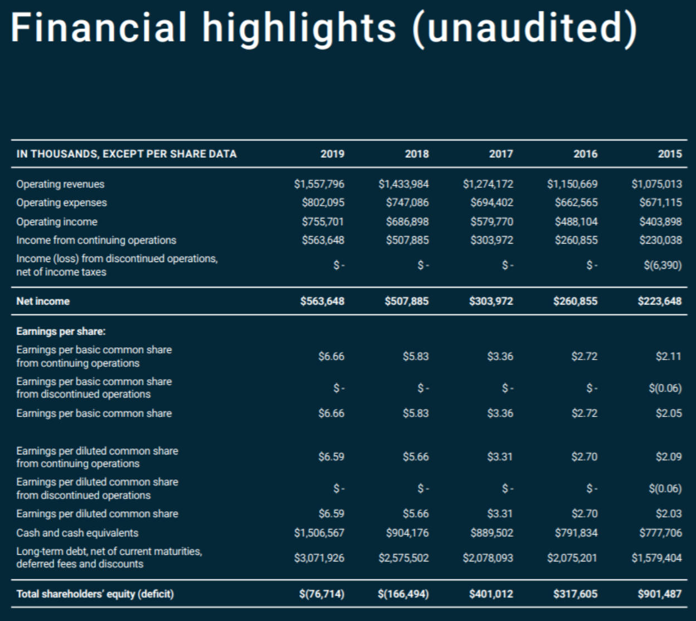
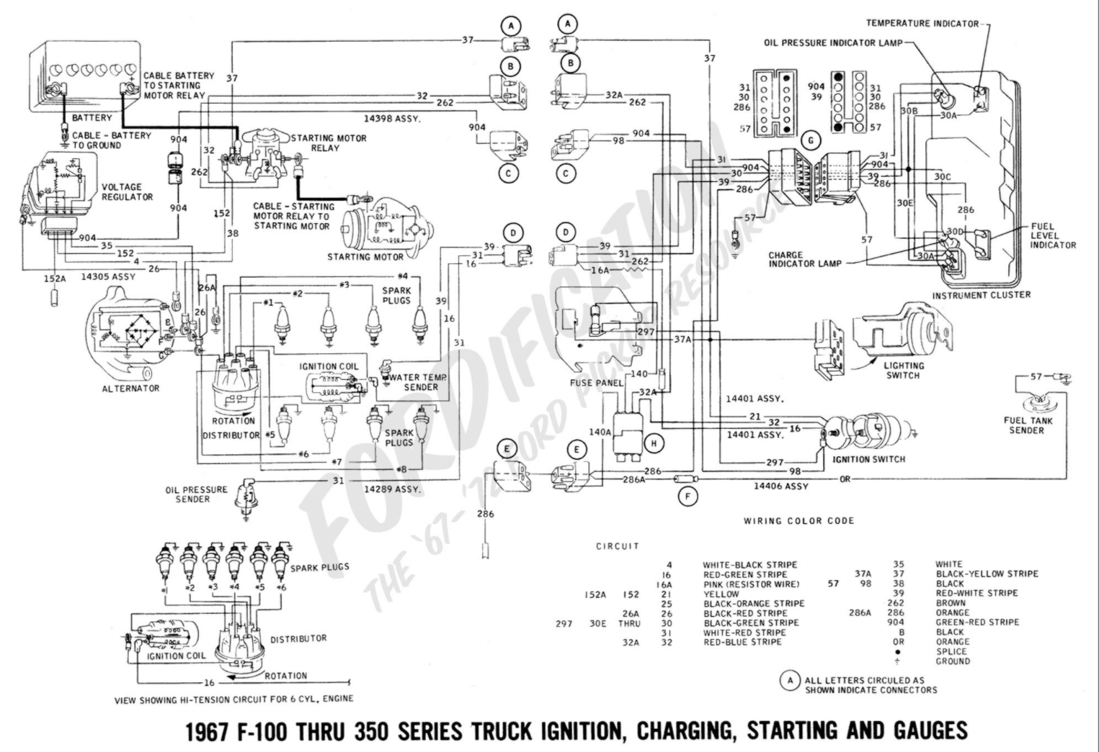
OCR Text Extraction from Images &Documents

Slide 8
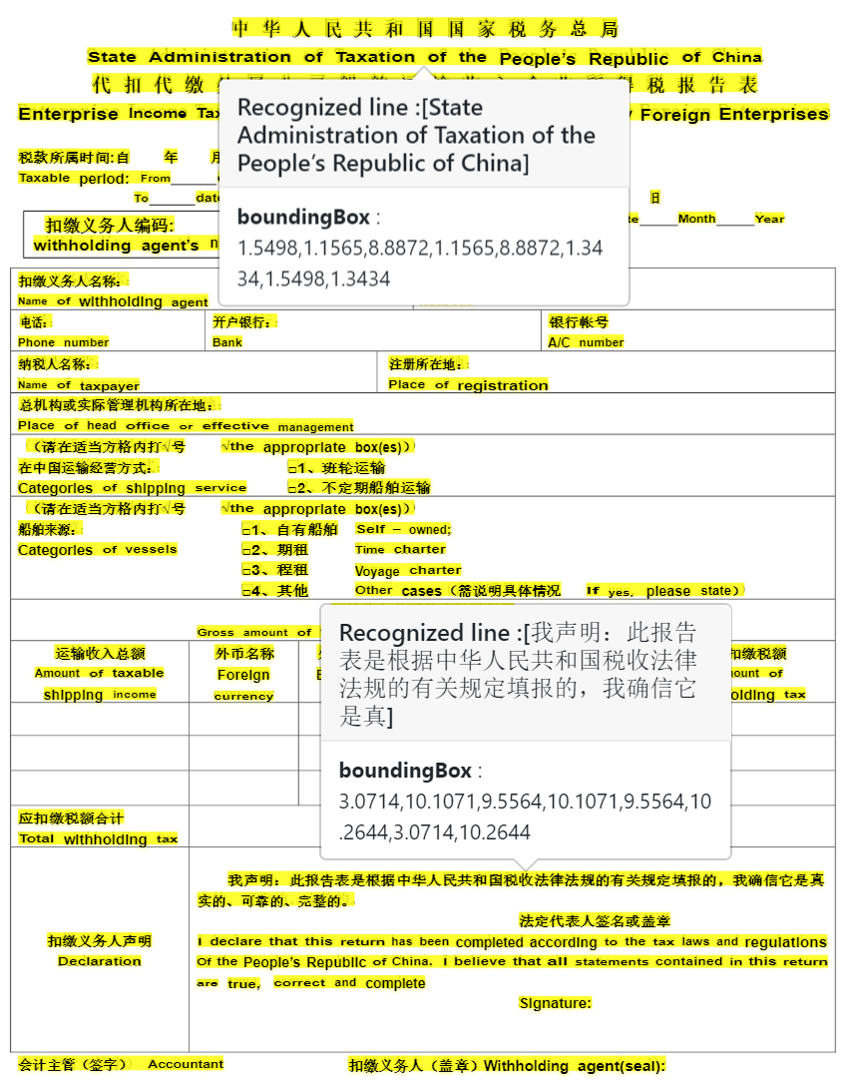
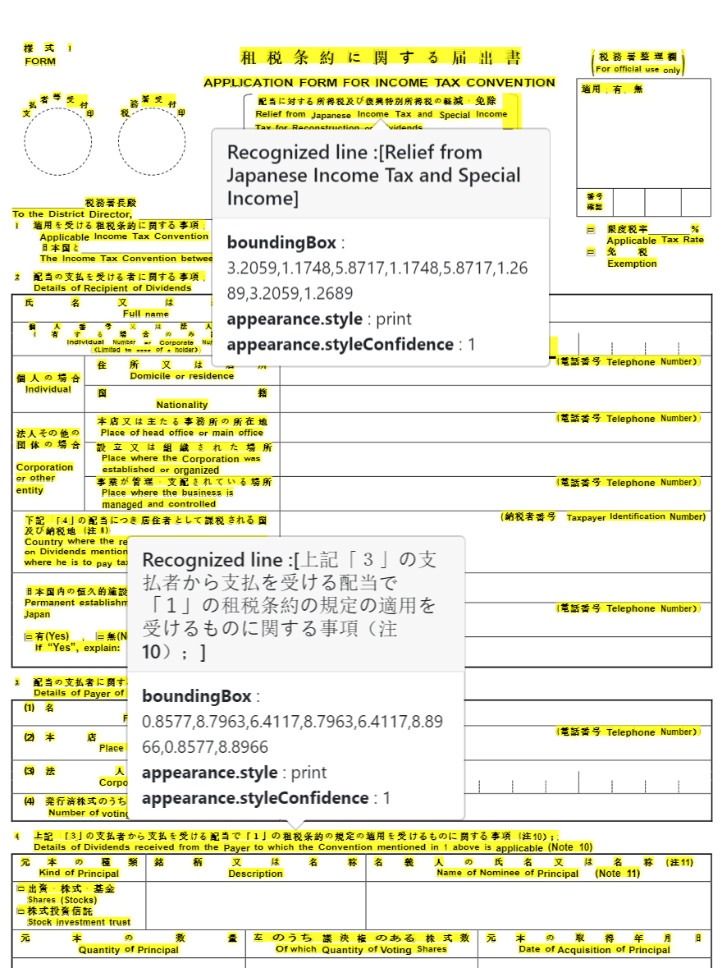
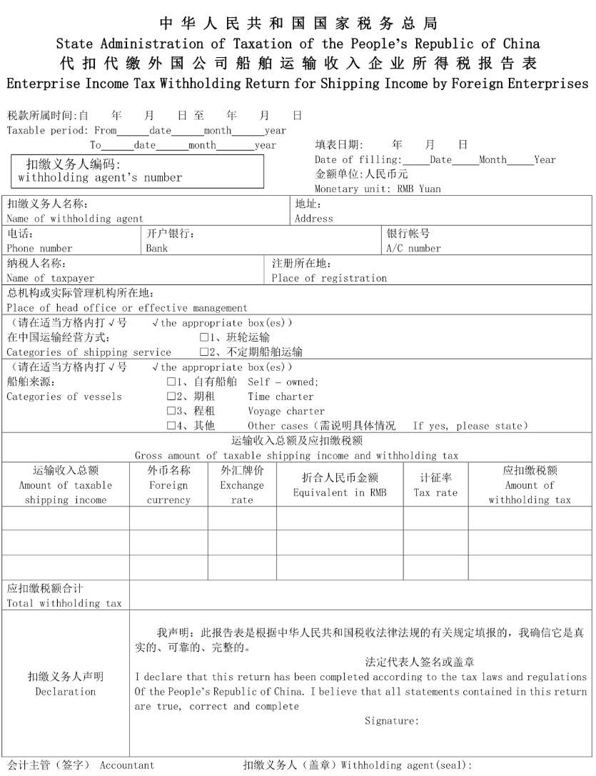
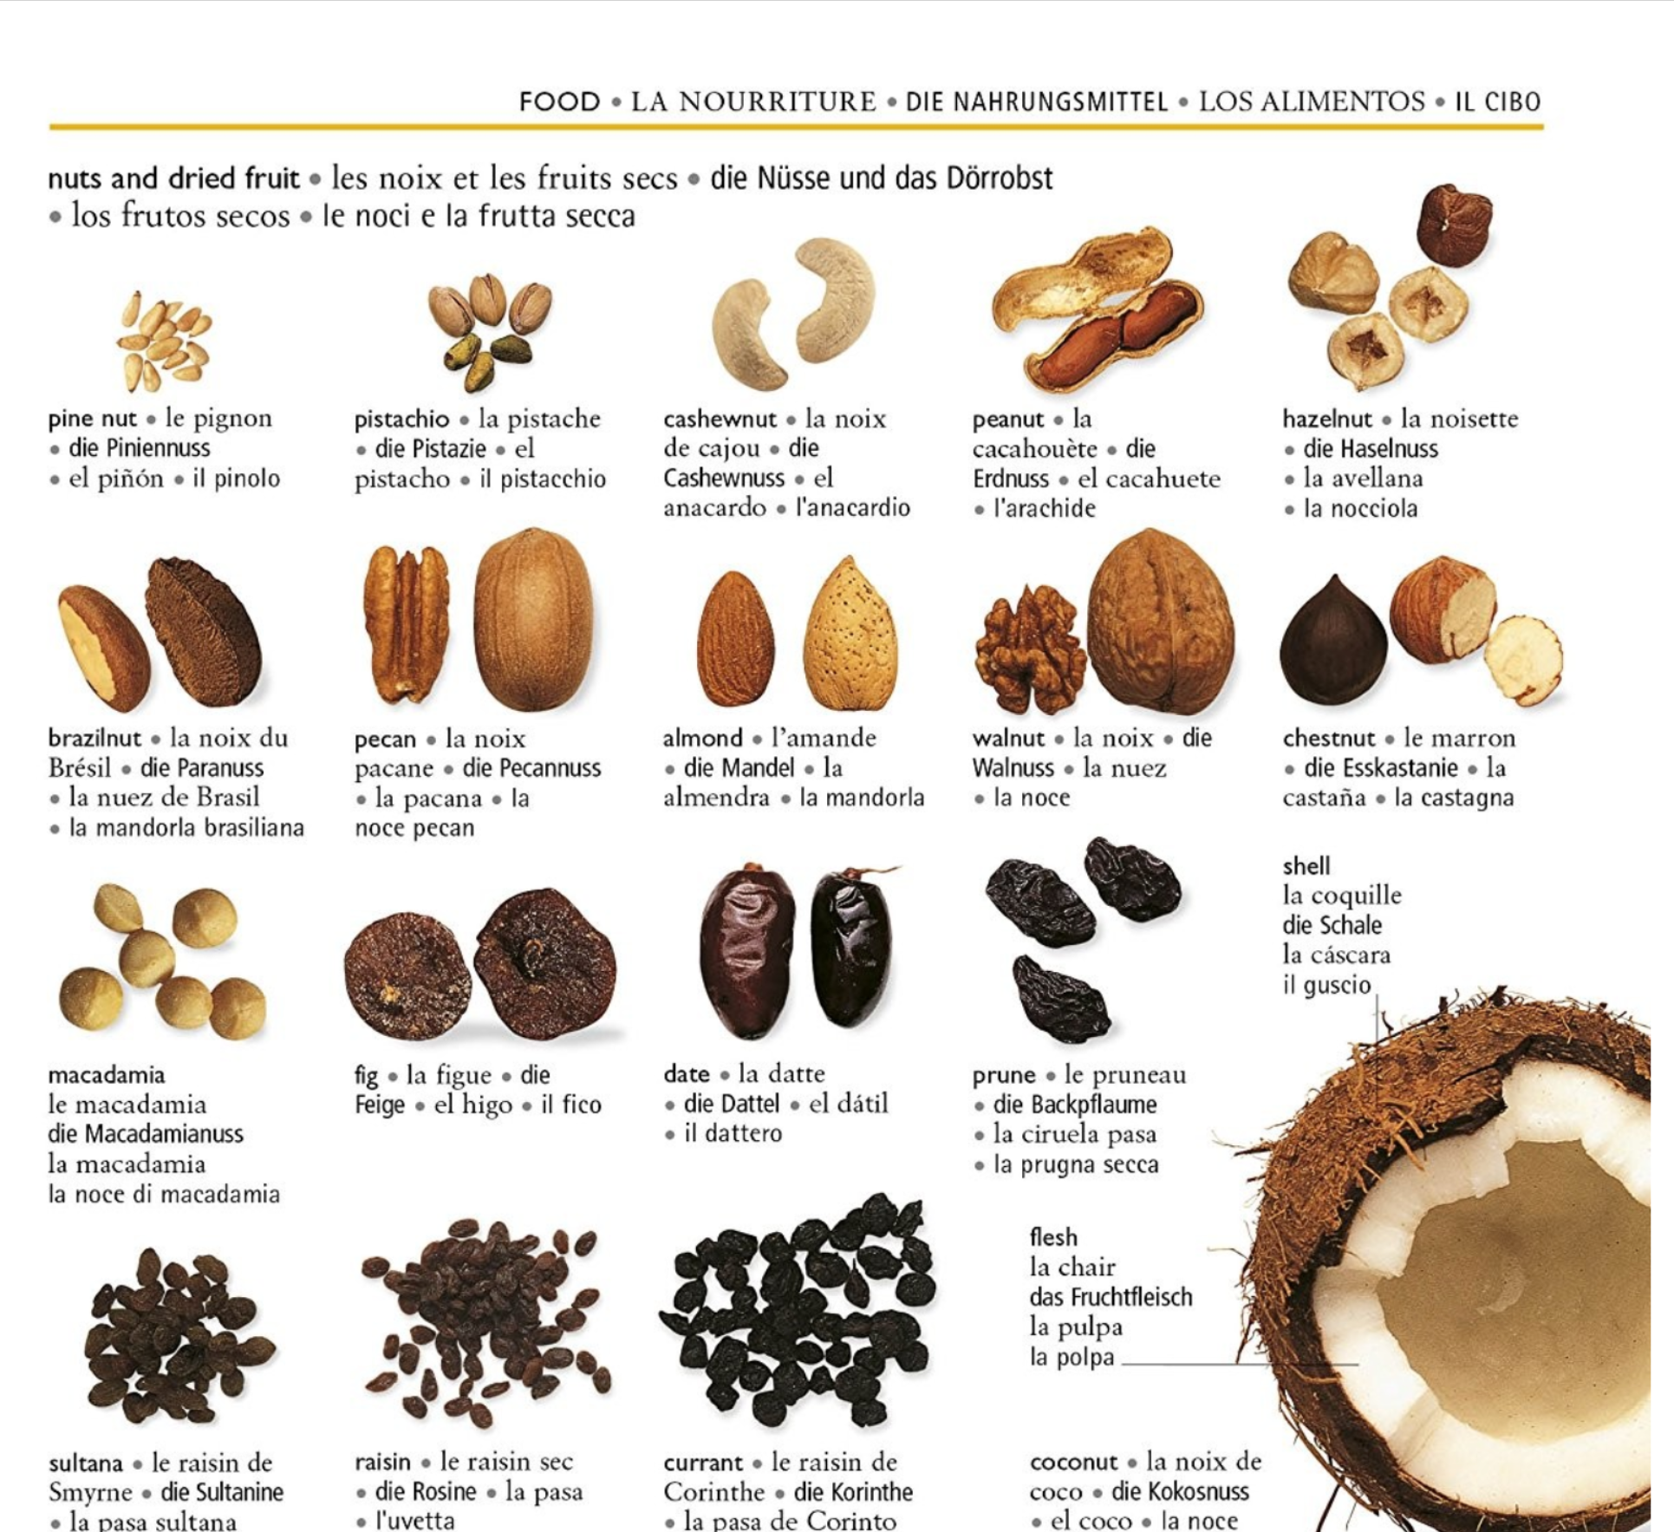
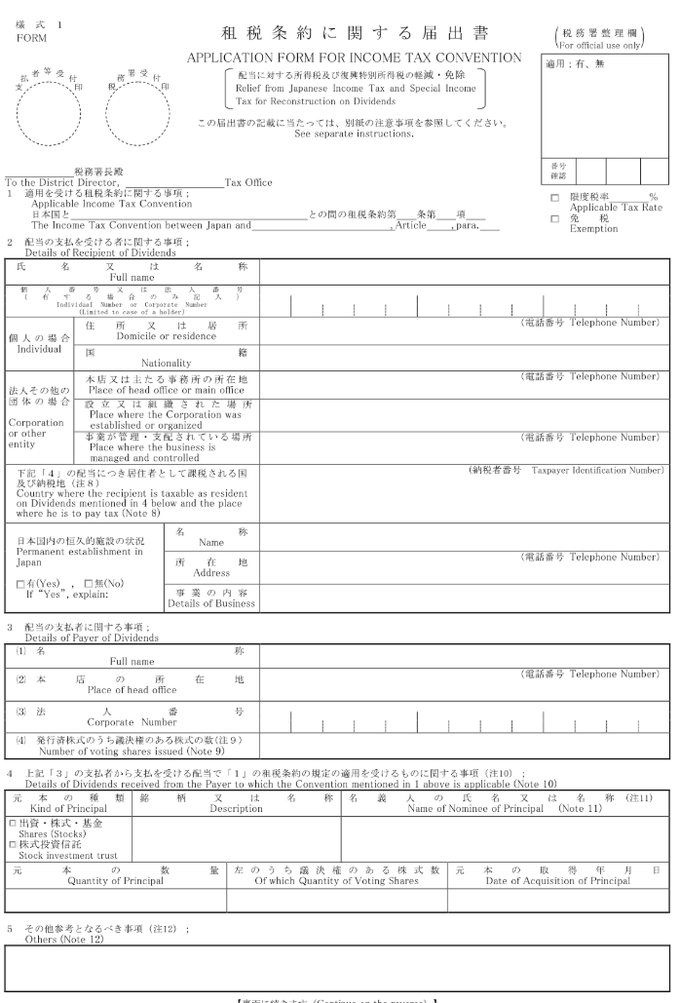
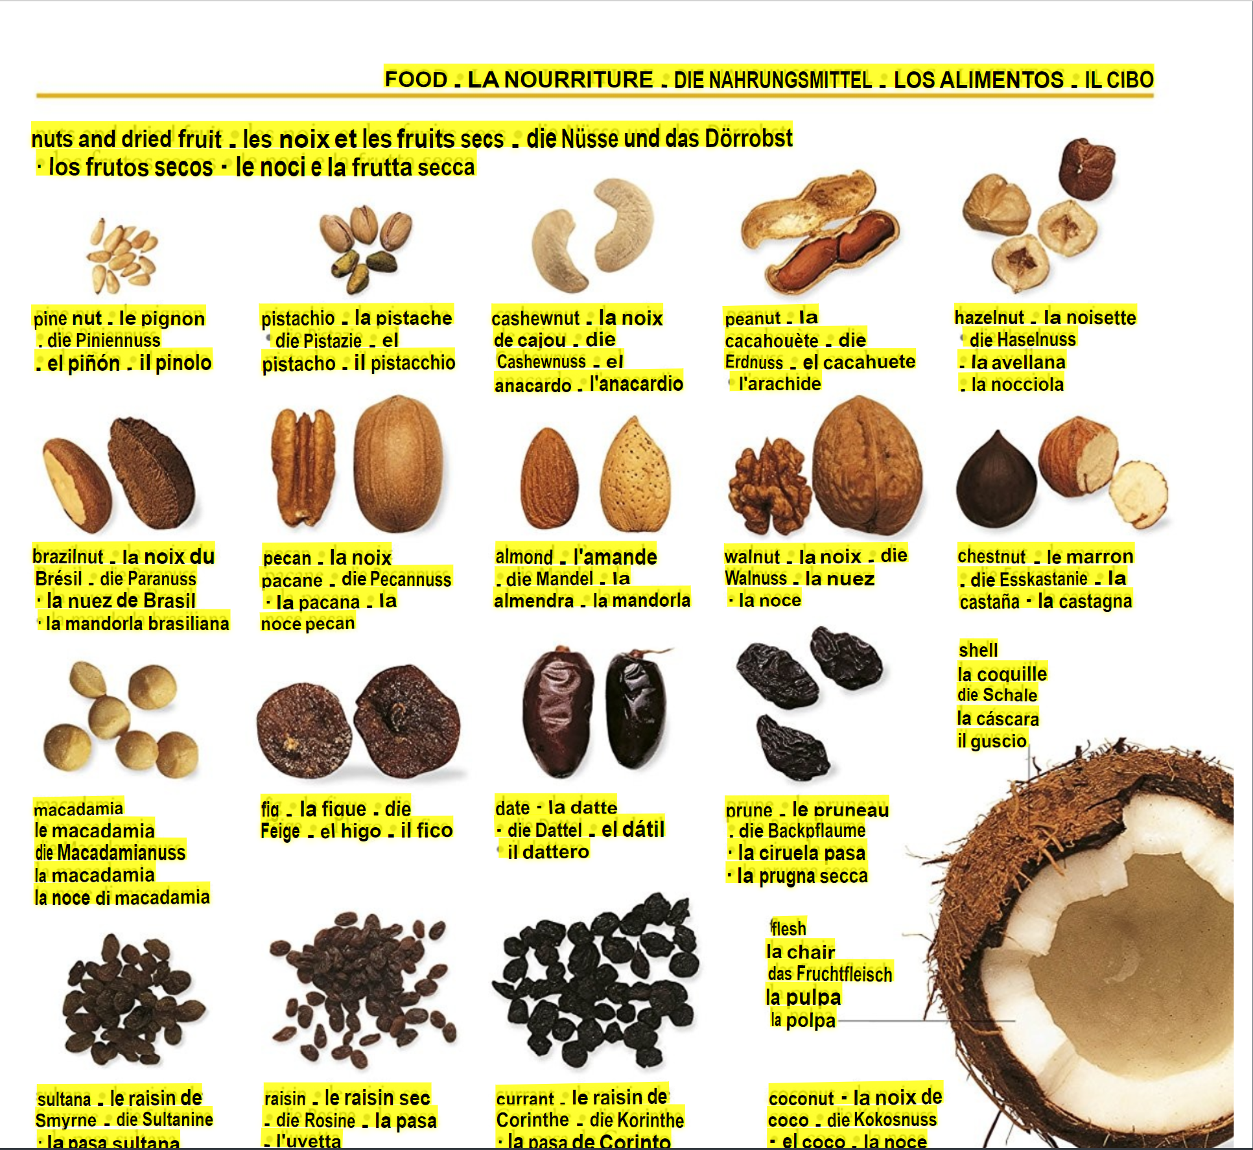
Example results: Mixed languages

Slide 9
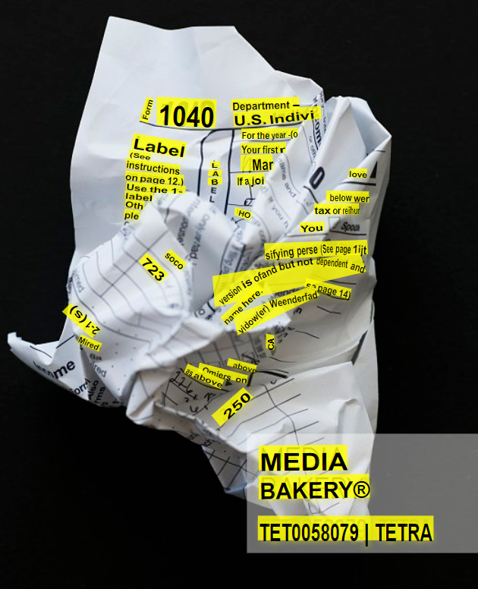
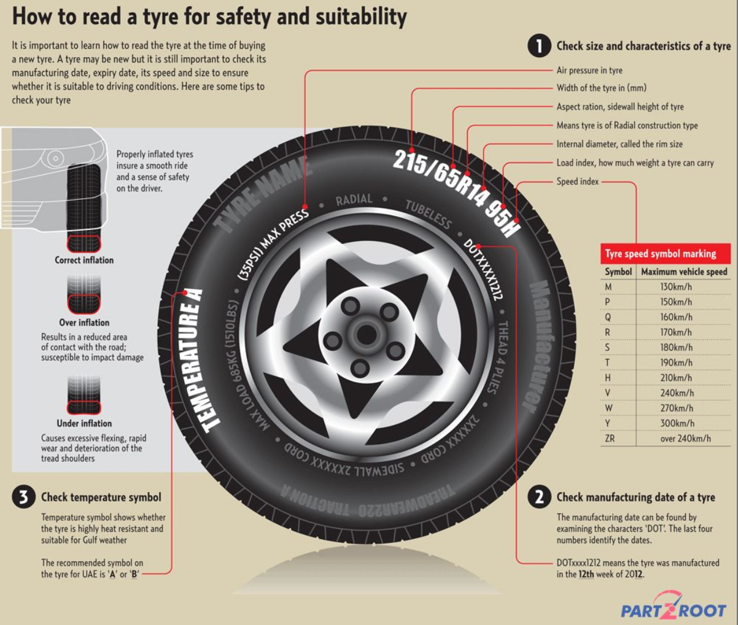
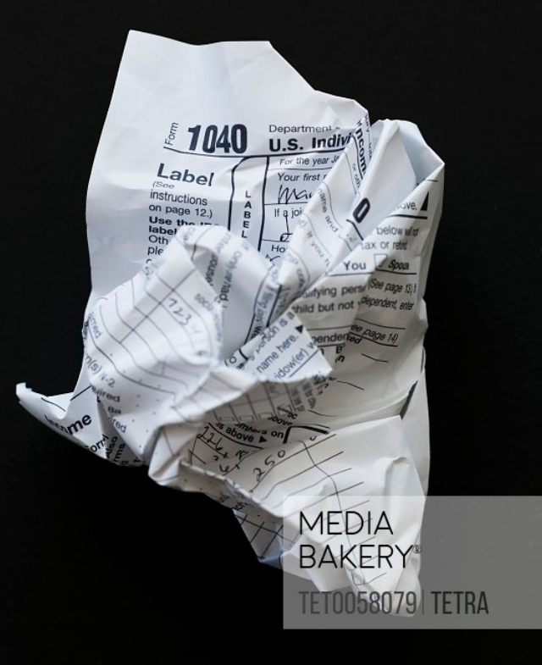
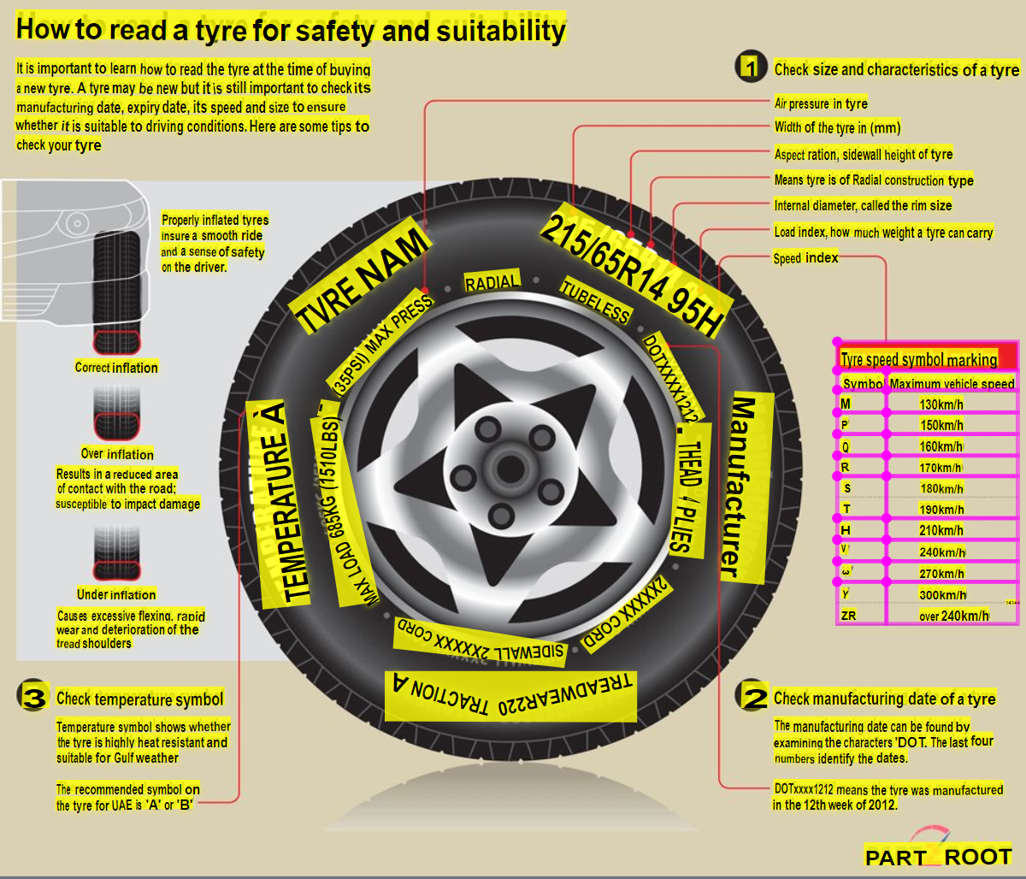
Example results: Diverse content

Slide 10
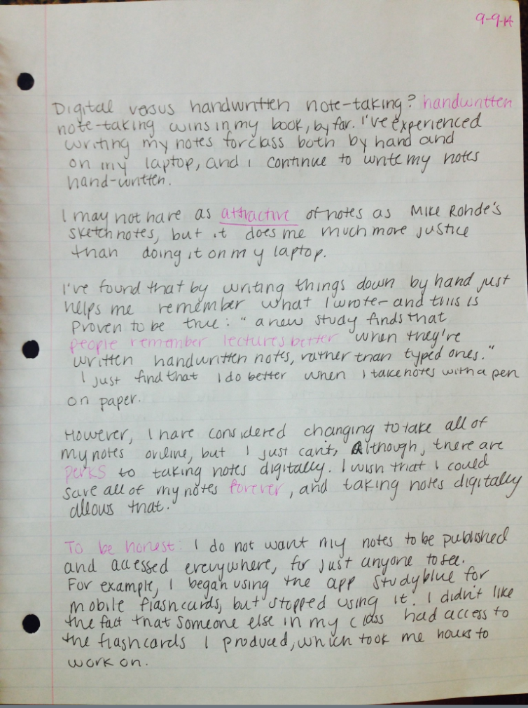
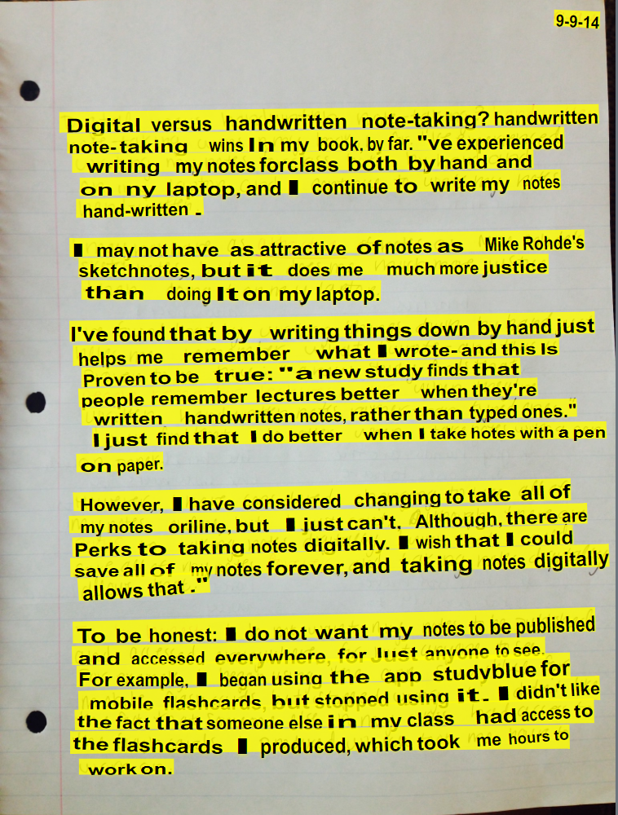
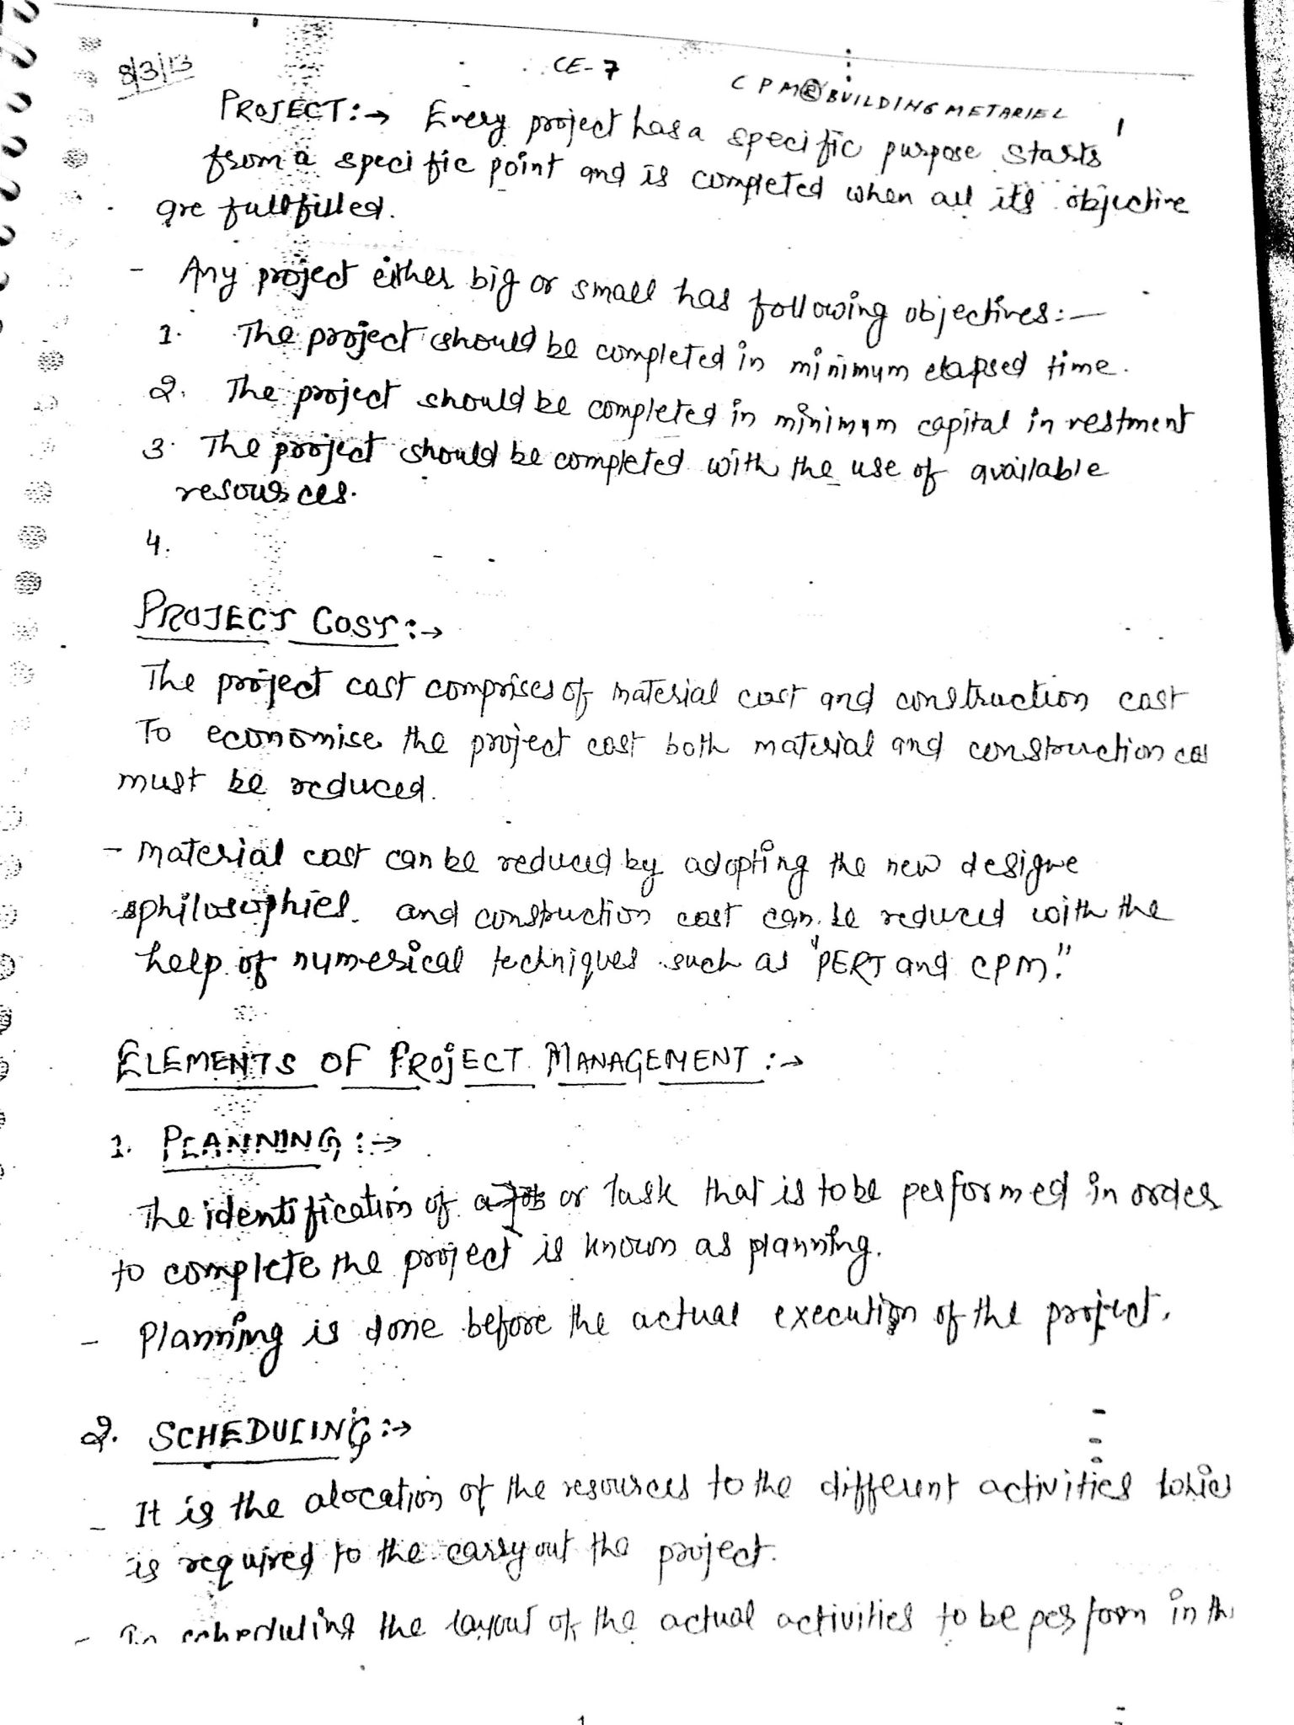
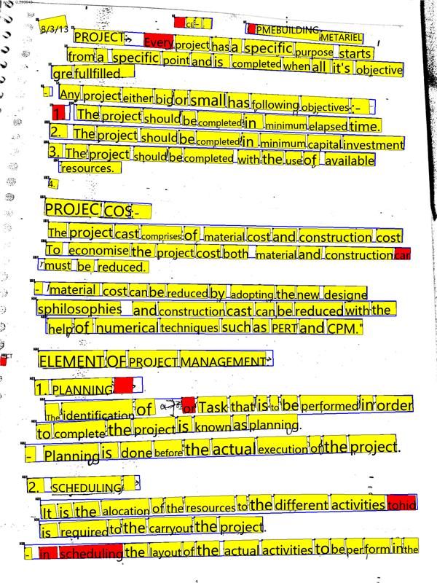
Example results: Handwritten text

Slide 11




How it works
Ingest Documents
Document Intelligent Models
Layout
Prebuilt
Custom
images
Pre-Processing
de-noising (improve resolution), background noise, watermarks removal
Receipts
Invoices
Templates
Train a model for structured documents
Text Extraction
Character, word, line, blocks read order bounding boxes
handwritten \ printed
ID
Extract text can be used in any applications
PDF
Insurance Cards
Segment analysis
Paragraphs, sections, headers, table of contents etc.
W2
Neural Model
Train a model for unstructured document
Word
Business Cards
Structure Recognition
Tables, selection Marks
Barcodes, images
Contacts
Health Insurance Cards
Only a handful of documents needed to get started and train a model
HTML
And more

Slide 12
Pretrained document-analysis models
Document type | Example | Data to extract | Your best solution
A generic document. | A contract or letter. | You want to primarily extract written or printed text lines, words, locations, and detected languages. | Read OCR model
A document that includes structural information. | A report or study. | In addition to written or printed text, you need to extract structural information like tables, selection marks, paragraphs, titles, headings, and subheadings. | Layout analysis model
A structured or semi-structured document that includes content formatted as fields (keys) and values. | A form or document that is a standardized format commonly used in your business or industry like a credit application or survey. | You want to extract fields and values including ones not covered by the scenario-specific prebuilt models without having to train a custom model. | **Layout analysis model with the optional query string parameter features=keyValuePairs enabled **

Slide 13
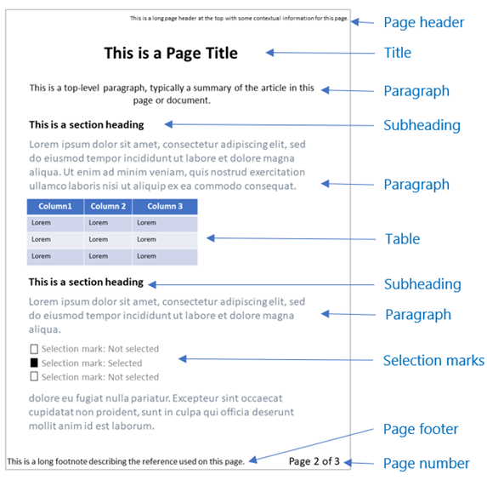
Layout Model
Extract text and their locations
Extract structural elements like tables and selection marks
Extracts print and handwritten text for the full list of supported languages
More structural elements like titles, headers, footers, paragraphs, etc.

Slide 14
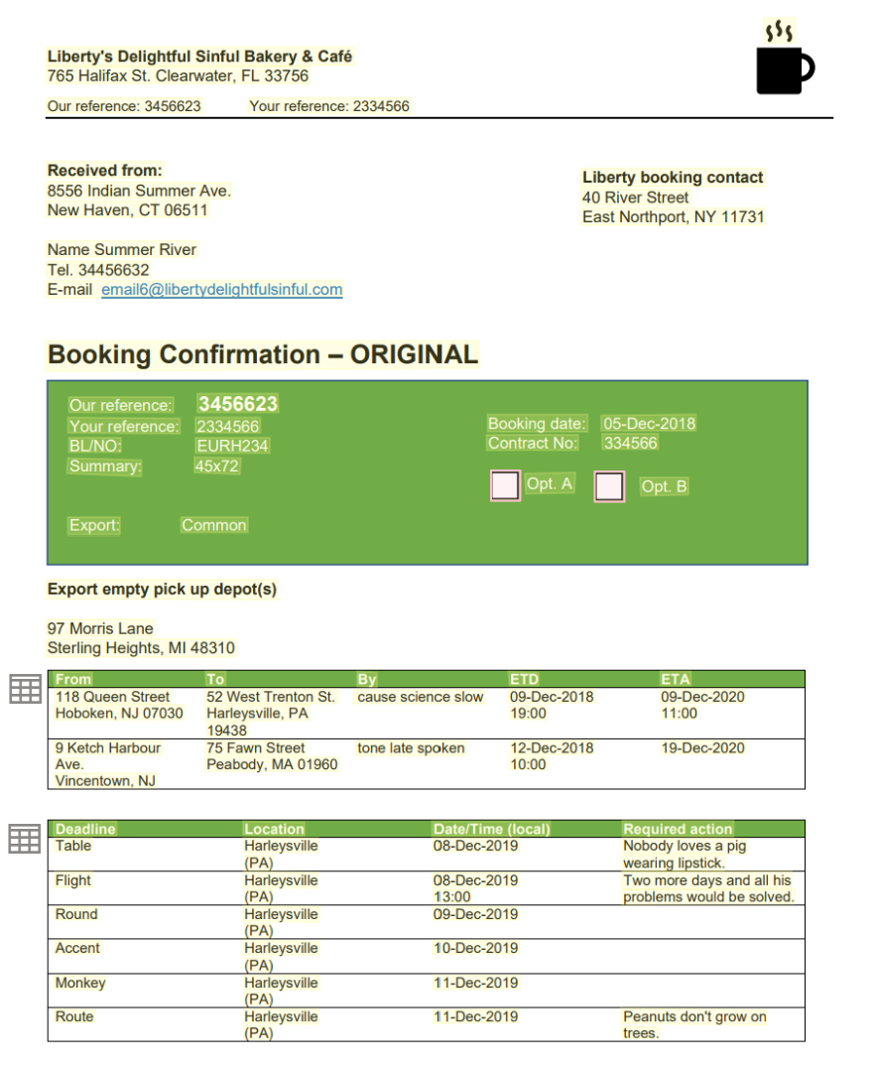
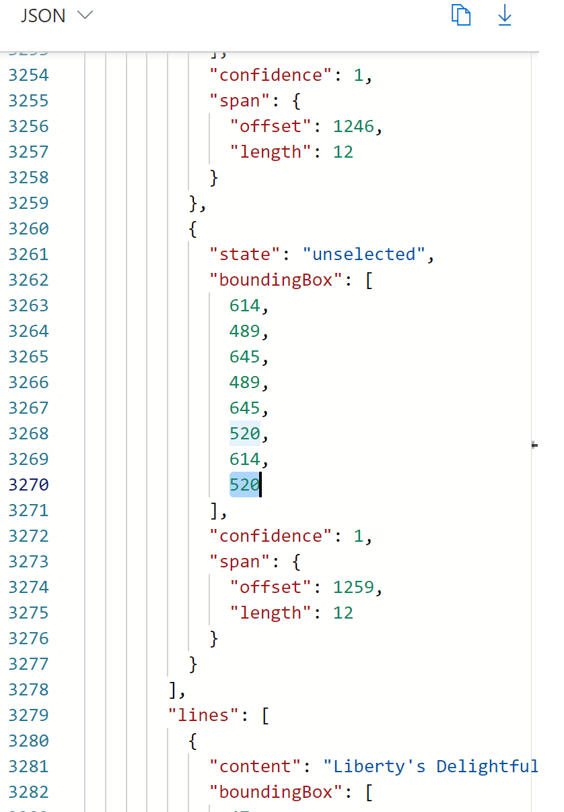
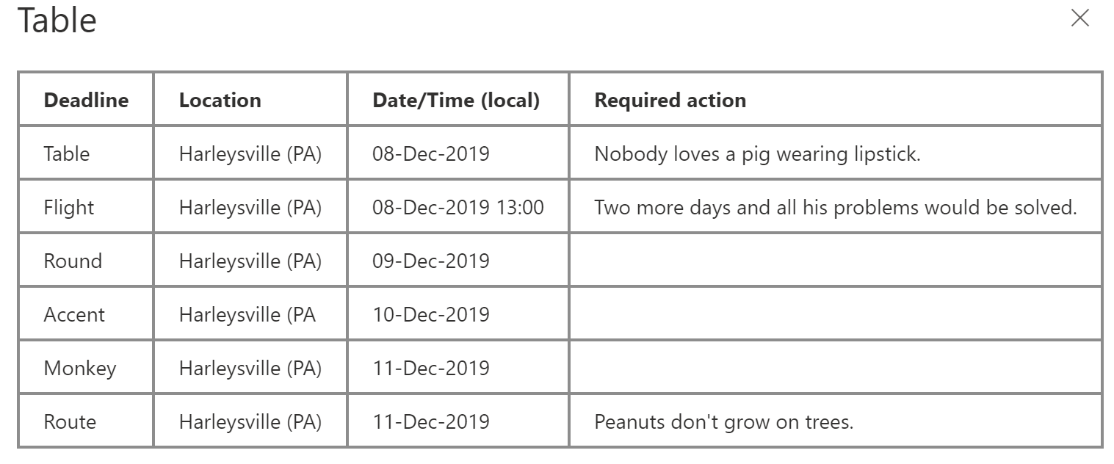
Layout Model
Layout model extracts text, tables, selection marks, and structure information from documents (PDF, TIFF) and images (JPG, PNG, BMP).

Slide 15
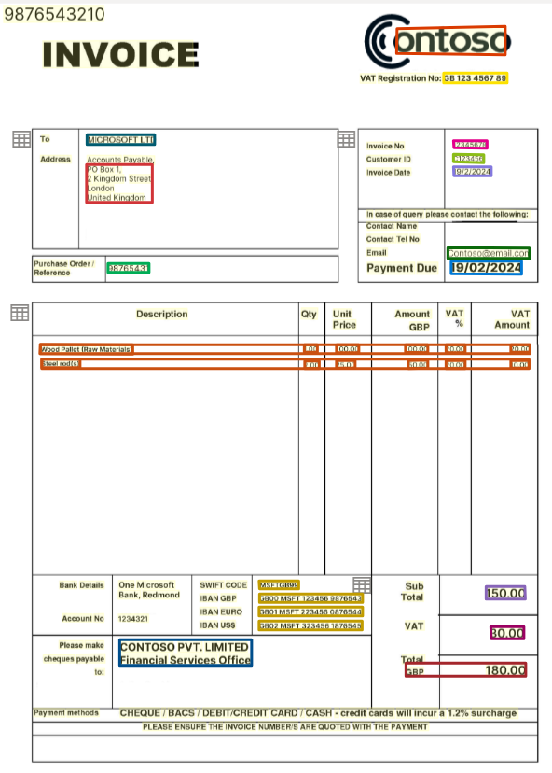
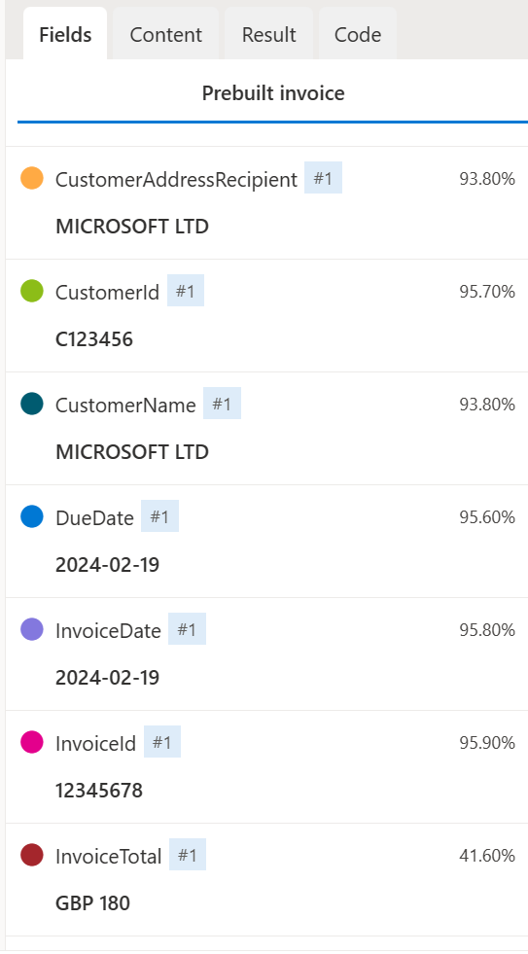
Field and Key Value pairs

Slide 16
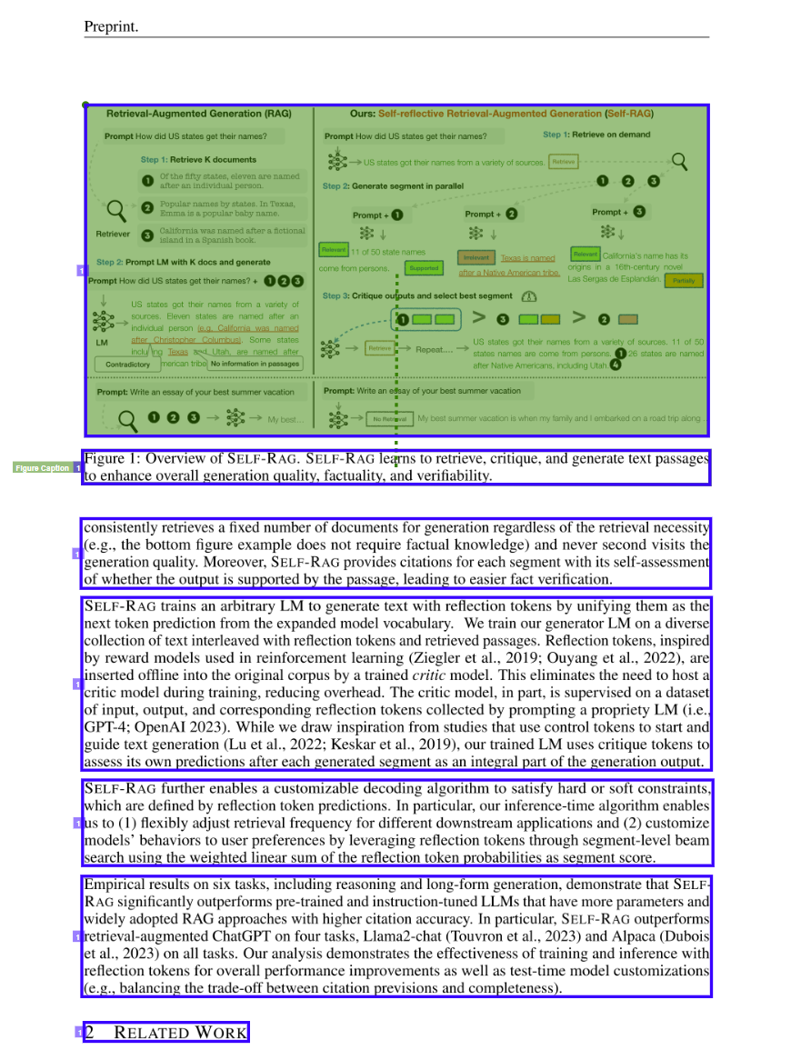
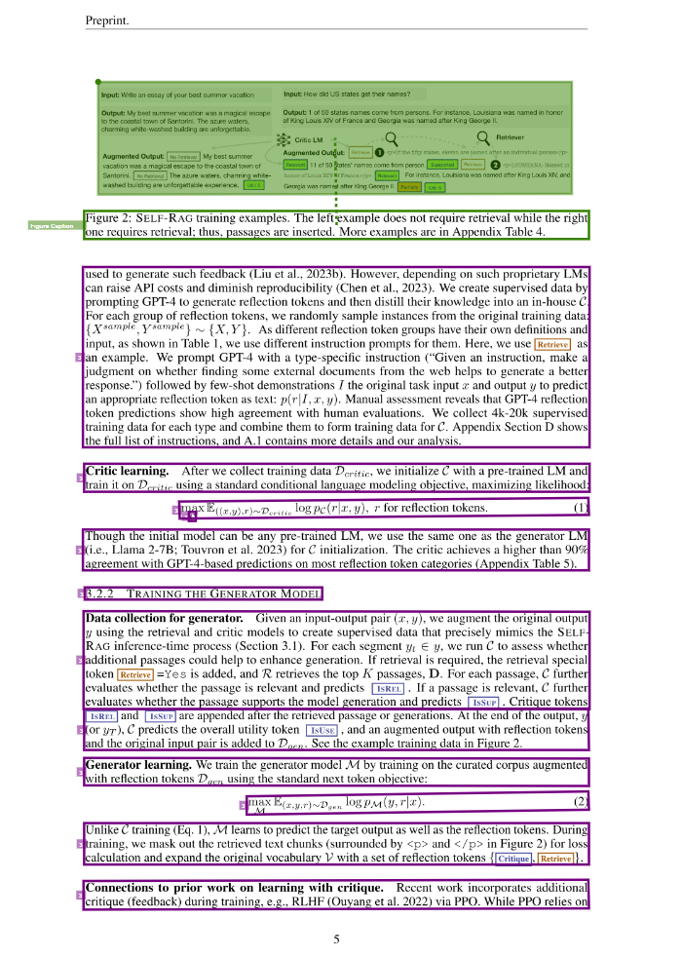
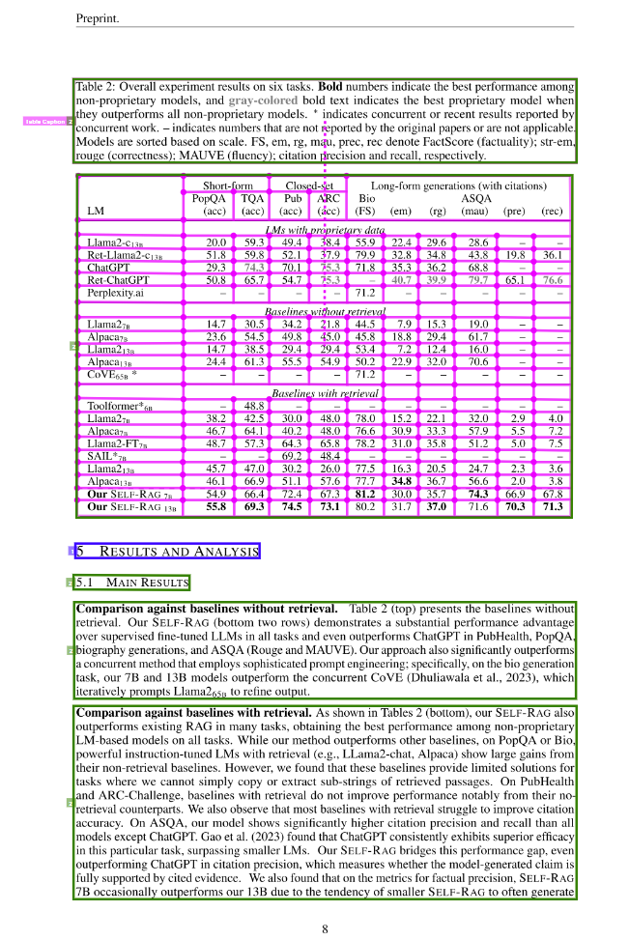
Latest update
Figures
Hierarchical Document Structure Analysis
Document layout analysis - Document Intelligence (formerly Form Recognizer) - Azure AI services | Microsoft Learn

Slide 17
Add-on Capabilities
Available for 2023-07-31 (GA) and later releases:
ocrHighResolution Recognizing small text from large-size documents, like engineering drawings, improves quality of content extraction from A1/A2/A3 documents by enabling this add-on capability
formulas
Extracts all identified formulas , such as mathematical equations, in LaTeX representation in the formulas collection as a top level object under content
styleFont
Barcodes
languages
Available for 2023-10-31-preview and later releases:
keyValuePairs
queryFields

Slide 18
Key Value Pair vs Query field
Key value pairs are only available with layout and invoice models. If you're looking to extend the schema for a prebuilt model, use query fields.
You don't know the specific fields to be extracted, or the number of fields is large (greater than 20), key value pairs might be a better solution.
Key-value pairs extract the keys and values as they exist in the form or document, you need to plan for any key variations. For example, keys First Name or Given Name. With query fields, you define the key and the model only extracts the corresponding value.
Use query fields when the value you require can't be described as a key value pair in the document. For example, the agreement date of a contract.

Slide 19
Analysis Features
Model ID | Content Extraction | Paragraphs | Paragraph Roles | Selection Marks | Tables | Key-Value Pairs | Languages | Barcodes | Document Analysis | Formulas* | Style Font* | High Resolution* | query fields
prebuilt-read | ✓ | ✓ |  |  |  |  | O | O |  | O | O | O
prebuilt-layout | ✓ | ✓ | ✓ | ✓ | ✓ | O | O | O |  | O | O | O | ✓
prebuilt-idDocument | ✓ |  |  |  |  |  | O | O | ✓ | O | O | O | ✓
prebuilt-invoice | ✓ |  |  | ✓ | ✓ | O | O | O | ✓ | O | O | O | ✓
prebuilt-receipt | ✓ |  |  |  |  |  | O | O | ✓ | O | O | O | ✓
prebuilt-healthInsuranceCard.us | ✓ |  |  |  |  |  | O | O | ✓ | O | O | O | ✓
prebuilt-tax.us.w2 | ✓ |  |  | ✓ |  |  | O | O | ✓ | O | O | O | ✓
prebuilt-tax.us.1098 | ✓ |  |  | ✓ |  |  | O | O | ✓ | O | O | O | ✓
prebuilt-tax.us.1098E | ✓ |  |  | ✓ |  |  | O | O | ✓ | O | O | O | ✓
prebuilt-tax.us.1098T | ✓ |  |  | ✓ |  |  | O | O | ✓ | O | O | O | ✓
prebuilt-tax.us.1099(Variations) | ✓ |  |  | ✓ |  |  | O | O | ✓ | O | O | O | ✓
prebuilt-contract | ✓ | ✓ | ✓ | ✓ |  |  | O | O | ✓ | O | O | O | ✓
{ customModelName } | ✓ | ✓ | ✓ | ✓ | ✓ |  | O | O | ✓ | O | O | O | ✓
prebuilt-document (deprecated 2023-10-31-preview) | ✓ | ✓ | ✓ | ✓ | ✓ | ✓ | O | O |  | O | O | O
prebuilt-businessCard (deprecated 2023-10-31-preview) | ✓ |  |  |  |  |  |  |  | ✓
✓ - Enabled O - Optional * - Premium features incur extra costs.
What is Azure AI Document Intelligence (formerly Form Recognizer)? - Azure AI services | Microsoft Learn

Slide 20
Analysis Features
"paragraphs": [
{
"spans": [],
"boundingRegions": [],
"content": "While healthcare is still in the early stages of its Al journey, we are seeing pharmaceutical and other life sciences organizations making major investments in Al and related technologies.\" TOM LAWRY | National Director for Al, Health and Life Sciences | Microsoft"
}
]
"words": [
{
"content": "While",
"polygon": [],
"confidence": 0.997,
"span": {}
},
]
"lines": [
{
"content": "While healthcare is still in the early stages of its Al journey, we",
"polygon": [],
"spans": [],
}
]

Slide 21
Analysis Features
"pages": [
{
"pageNumber": 1,
"angle": 0,
"width": 915,
"height": 1190,
"unit": "pixel",
"words": [],
"lines": [],
"spans": []
}
]
"styles": [
{
"confidence": 0.95,
"spans": [
{
"offset": 509,
"length": 24
}
"isHandwritten": true
]
}
Showing if the text is handwritten

Slide 22
Custom Extraction Models
Custom Template Model & Custom Neural Model
If the language of documents and extraction scenarios supports custom neural models, it is recommended to use custom neural models over template models for higher accuracy.
Feature | Custom template (form) | Custom neural (document)
Document structure | Template, form, and structured | Structured, semi-structured, and unstructured
Training time | 1 to 5 minutes | 20 minutes to 1 hour
Data extraction | Key-value pairs, tables, selection marks, coordinates, and signatures | Key-value pairs, selection marks and tables
Document variations | Requires a model per each variation | Uses a single model for all variations
Language support | Printed and handwritten 300 languages Multiple language support | Printed and handwritten 48 languages language support
Accuracy | Generated during training | Requires a validation dataset to be computed

Slide 23
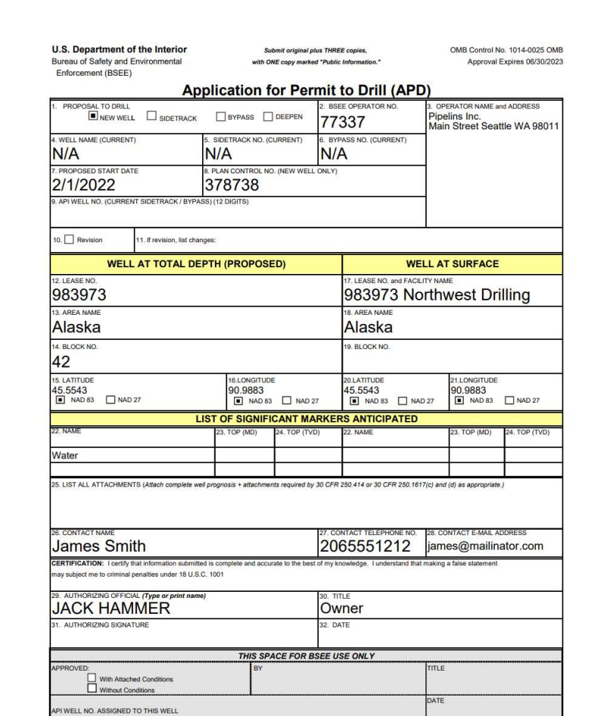
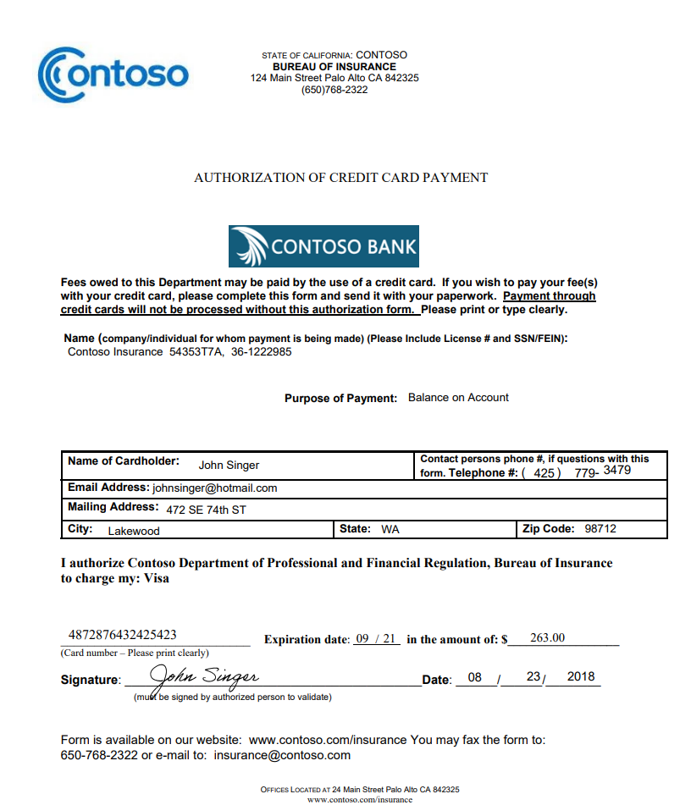
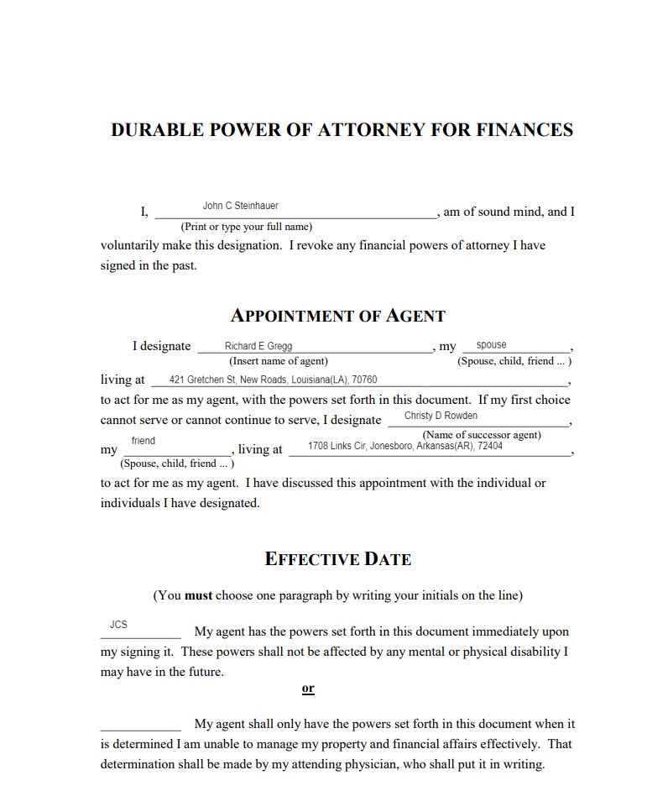
Template vs Neural Documents
Structured
Semi-Structured
Unstructured
Template
Neural

Slide 24
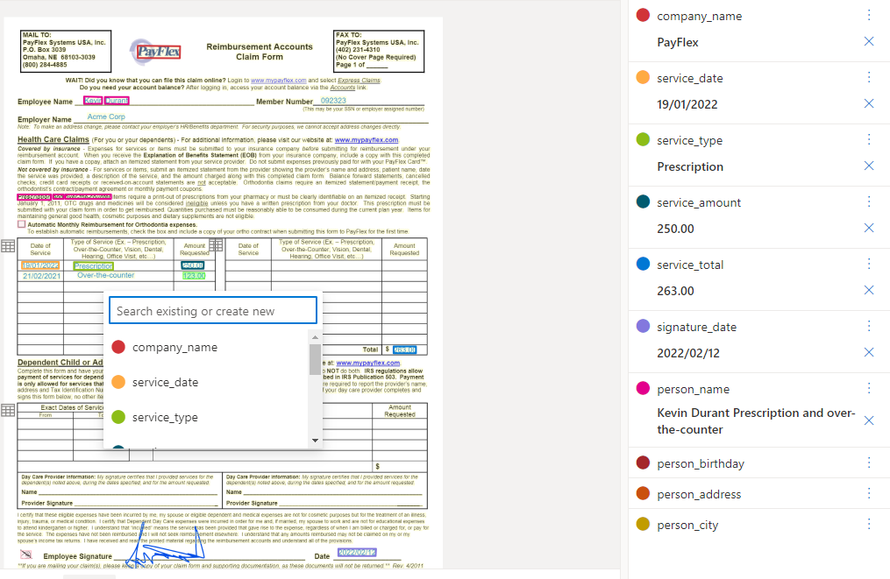
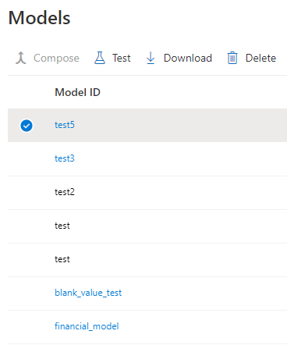
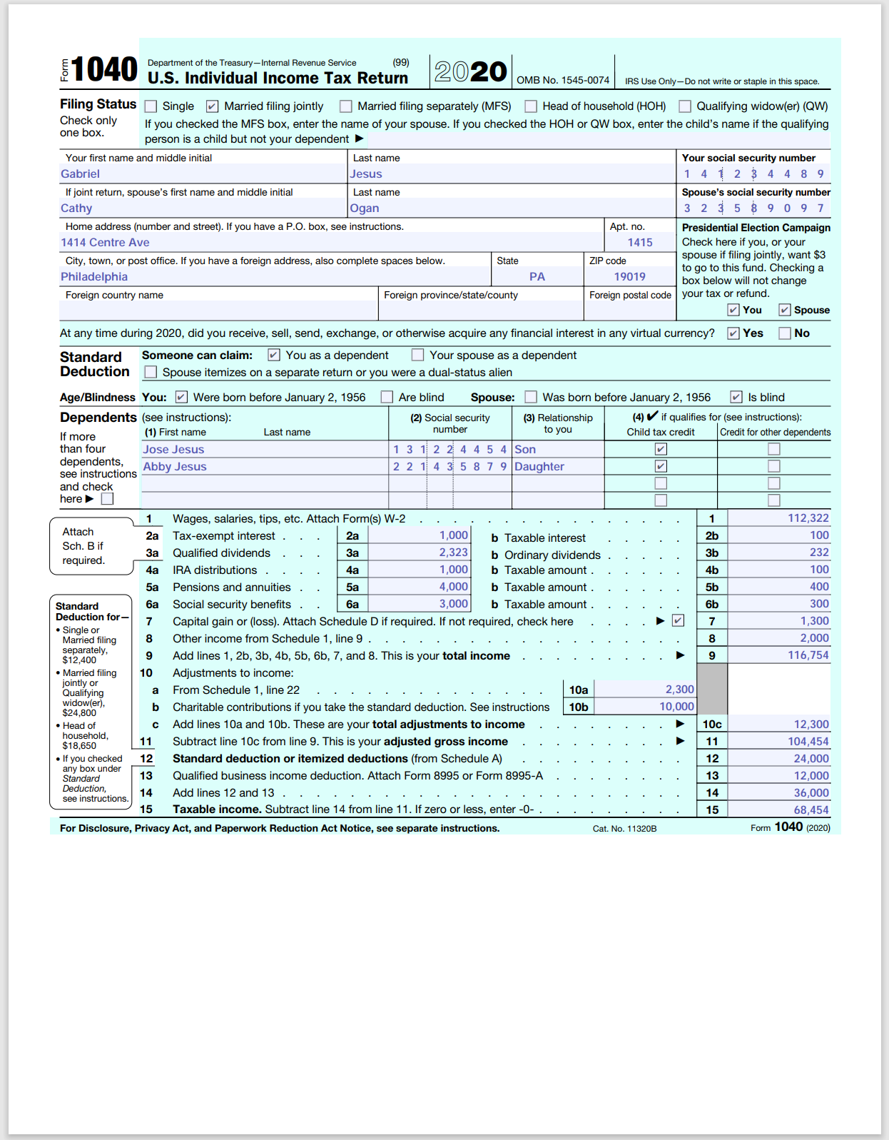
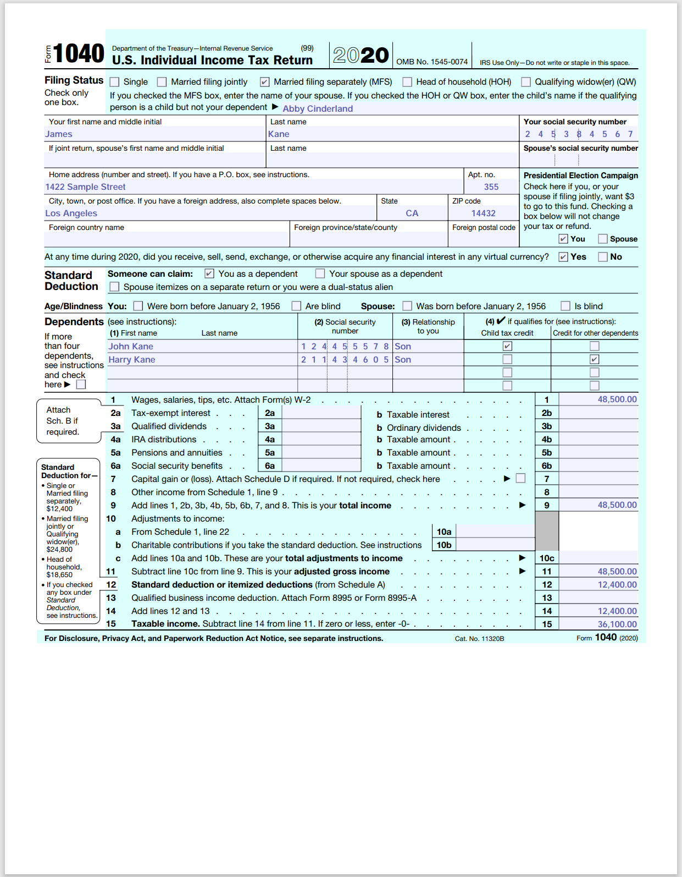
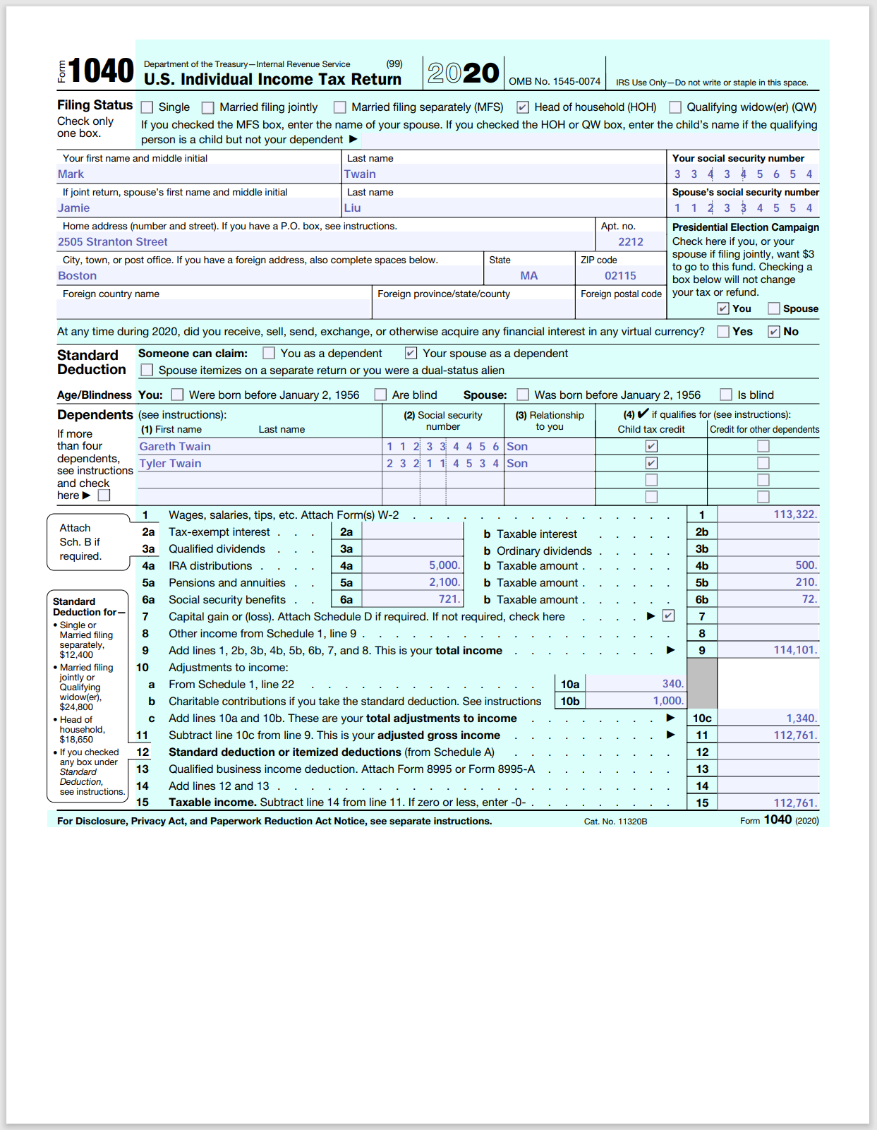


Train a custom model
Prepare documents
Labeling
Training

Slide 25
Labeling Best Practices
Document formats: If you expect to analyze both digital and scanned documents, add a few examples of each type to the training dataset
Tables: For documents containing tables with a variable number of rows, ensure that the training dataset also represents documents with different numbers of rows.
Multi page tables: When tables span multiple pages, label a single table. Add documents to the training dataset with the expected variations represented—documents with the table on a single page only and documents with the table spanning two or more pages with all the rows labeled.
Optional fields: If your dataset contains documents with optional fields, validate that the training dataset has a few documents with the options represented.
Region labeling (custom template). Labeling specific regions allows you to define a value when none exists. If the value is optional, ensure that you leave a few sample documents with the region not labeled. When labeling regions, don't include the surrounding text with the label.
Overlapping fields (custom neural). Label the field overlaps using region labeling. Ensure that you have at least on sample that describes how the fields can overlap in your training dataset.

Slide 26
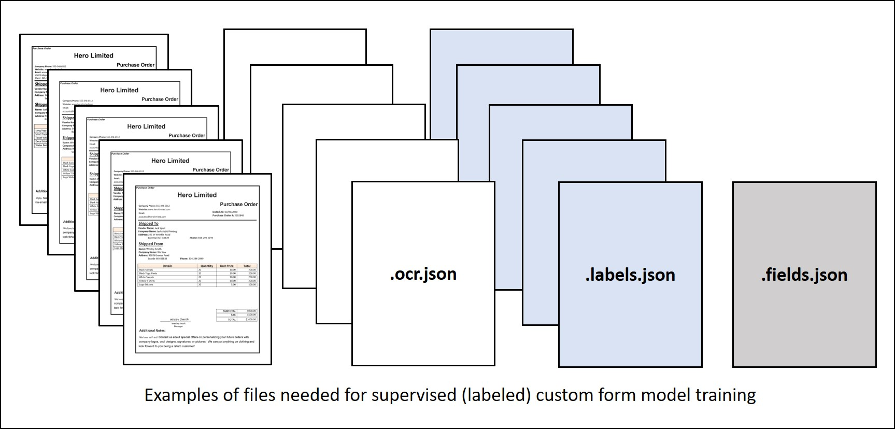

Slide 27
Composed Model
Assign multiple custom models to a composed model called with a single model ID
Custom form and Custom template models can be composed together into a single composed model
For custom template models, the composed model can be created using variations of a custom template or different form types. This operation is useful when incoming forms belong to one of several templates.
For Custom neural models the best practice is to add all the different variations of a single document type into a single training dataset and train on custom neural model unless there are more than 15 variations

Slide 28
Custom Classification Model
Deep-learning-model types that combine layout and language features to accurately detect and identify documents
Custom classification models can analyze a single- or multi-file documents to identify if any of the trained document types are contained within an input file. Here are the currently supported scenarios:
A single file containing one document. For instance, a loan application form.
A single file containing multiple documents. For instance, a loan application package containing a loan application form, payslip, and bank statement.
A single file containing multiple instances of the same document. For instance, a collection of scanned invoices.
Incremental training
Classifier models now support incremental training where you can reference an existing classifier and append new samples for an existing class or add new classes with samples
supported with models trained with API version 2024-02-29-preview and later

Slide 29
Supported File Format
Model | PDF | Image: JPEG/JPG, PNG, BMP, TIFF, HEIF | Microsoft Office: Word (DOCX), Excel (XLSX), PowerPoint (PPTX), and HTML
Read | ✔ | ✔ | ✔
Layout | ✔ | ✔ | ✔ (2023-10-31-preview)
General Document | ✔ | ✔
Prebuilt | ✔ | ✔
Custom | ✔ | ✔
Document processing models - Document Intelligence (formerly Form Recognizer) - Azure AI services | Microsoft Learn

Slide 30
Pricing
General
Container pricing is the same as cloud service pricing.
Has Free tier & Commitment tier
Custom Model
Training a custom model is free but there are charges when analyzing a document with a model for preparing training data
File format | Computed page unit | Total pages
Images (JPEG/JPG, PNG, BMP, HEIF) | Each image = 1 page unit | Total images
PDF | Each page in the PDF = 1 page unit | Total pages in the PDF
TIFF | Each image in the TIFF = 1 page unit | Total images in the PDF
Word (DOCX) | Up to 3,000 characters = 1 page unit, embedded or linked images not supported | Total pages of up to 3,000 characters each
Excel (XLSX) | Each worksheet = 1 page unit, embedded or linked images not supported | Total worksheets
PowerPoint (PPTX) | Each slide = 1 page unit, embedded or linked images not supported | Total slides
HTML | Up to 3,000 characters = 1 page unit, embedded or linked images not supported | Total pages of up to 3,000 characters each
Document Intelligence (formerly Form Recognizer) frequently asked questions (FAQ) | Microsoft Learn

Slide 31
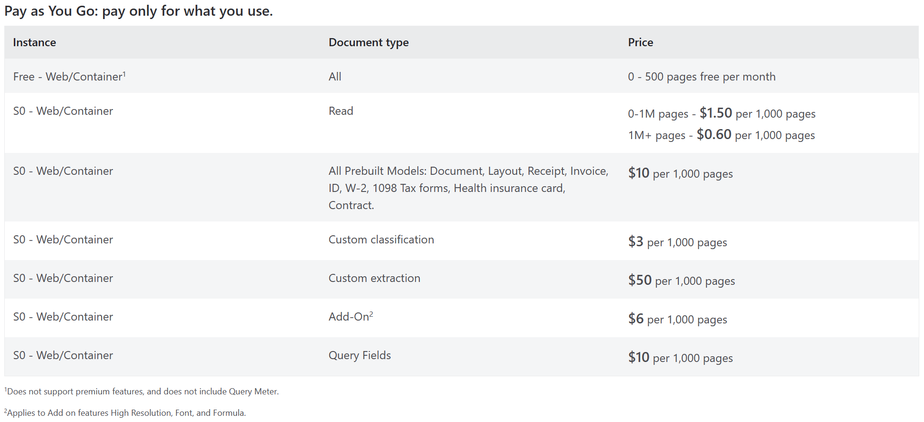
Pricing
Pricing - Azure AI Document Intelligence | Microsoft Azure

Slide 32
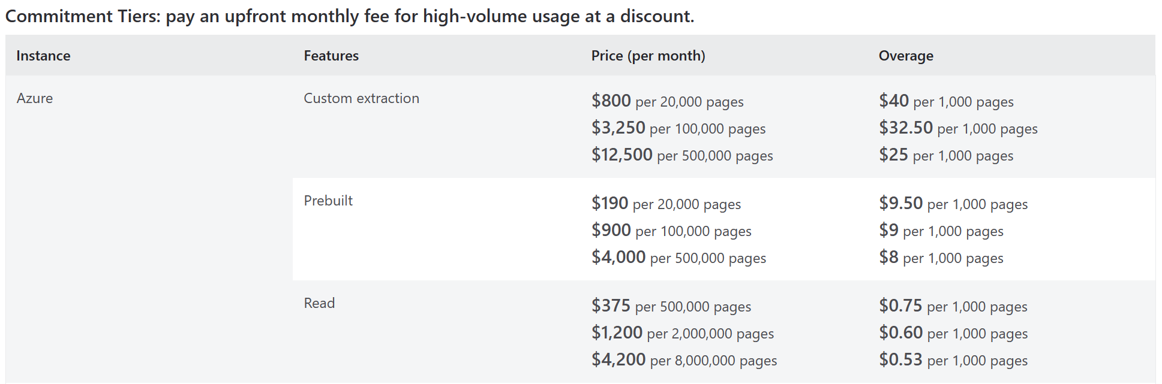
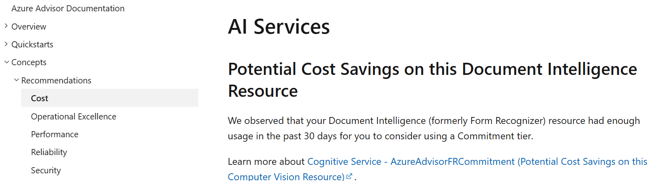

Commitment Tier
Azure Advisor provides recommendation to consider Commitment tier

Slide 33

Commitment Tier
Use Azure AI containers on-premises - Azure AI services | Microsoft Learn

Slide 34













Retrieval-Augmented Generation
Azure AI Search
Data Sources
Chunk
Extract
Index
Query ->Knowledge
Azure AI Document Intelligence
App UX
App Server, Orchestrator
Simplified process – a single API call for different file types.
Scalability and AI quality – High quality OCR & document analysis covering 309 printed and 12 handwritten languages.
LLM compatibility – Output LLM friendly (e.g., markdown)
Prompt + Knowledge -> Response
X
MD
Azure OpenAI
(GPT/ChatGPT)
… …
Retrieval-Augmented Generation (RAG) with Azure AI Document Intelligence (formerly Form Recognizer) - Azure AI services | Microsoft Learn

Slide 35





Challenges in RAG

Slide 36


LangChain component
https://aka.ms/doc-gen-ai

Slide 37
Semantic Chunking in RAG
Dividing a large body of text or documents into smaller, meaningful chunks based on their semantic content rather than arbitrary splits
Azure AI Search
Data Sources
Semantic chunk
Extract
Index
Query ->Knowledge
Azure AI Document Intelligence
App UX
App Server, Orchestrator
Why semantic chunking?
Efficient storage and retrieval – Relevant "semantic units" of information can be stored & fetched as opposed to arbitrary snippets.
Improved relevance – Retrieve passages that are contextually and semantically relevant to the query.
Enhanced interpretability – Interpretable as standalone pieces of information aids in transparency and traceability of the generated responses
Prompt + Knowledge -> Response
X
Azure OpenAI
(GPT/ChatGPT)
MD
… …

Slide 38
Additional Resources
Documentation
Document Intelligence documentation - Quickstarts, Tutorials, API Reference - Azure AI services | Microsoft Learn
Quick start
https://aka.ms/doc-intelligence-quickstart
Try out the RAG sample
https://aka.ms/doc-gen-ai
Document Intelligence Studio
https://aka.ms/distudio
Learning Path
Develop solutions with Azure AI Document Intelligence - Training | Microsoft Learn
Applied Skills
Create an intelligent document processing solution with Azure AI Document Intelligence - Applied Skills | Microsoft Learn

Slide 39
Thank you.

